Slide 1

Percentage Theory

Slide 2

Percentage Conversion Table:-
½ | 50 %
1/3 | 33.33 %
¼ | 25 %
1/5 | 20 %
1/6 | 16.66 %
1/7 | 14.28 %
1/8 | 12.5 %
1/9 | 11.11 %
1/10 | 10 %
1/11 | 9.09 %
1/12 | 8.33 %
1/13 | 7.69 %
1/14 | 7.14 %
1/15 | 6.66 %
1/16 | 6.25 %
44% = 4*11% = 4/9
21% = 7% *3
= 1/14 * 3 = 3/14
22% = 2*11%
=2/9
27% = 3/11
66% = 2/3
14% = 2/7
¾ | 75 %
½ | 50 %
3/8 | 37.5 %

Slide 3
What is the rise percentage?
% Rise = d/IV = 10/45
= 2/9
= 22%
By how much percentage IT is less than CSE?
1995 | 1996
45 | 55
CSE IT
32 42
% = 10/32
5/16
6.6 *5
= 33%

Slide 4
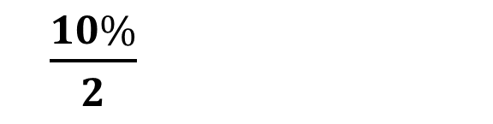
10% →
1 d less
1% →
2 d less
$\frac{10\%}{2}$
5% →
E.g. 1) 10% of 790 =
79
E.g. 2) 10% of 820 =
82
E.g. 3) 1% of 350 =
3.5
E.g. 4) 3% of 420 =
4.2 x 3 = 12.6
E.g 5) 15% of 540 =
10% + 5% = 54 + 27
= 81

Slide 5
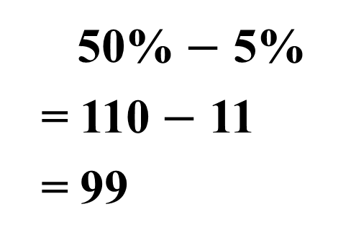
E.g → 30% of 720 =
72 x 3 = 216
E.g → 55% of 420 =
50% + 5%
= 210 + 21
= 231
E.g → 55% of 740 =
50% + 5%
= 370 + 37
= 407
E.g → 45% of 220 =
50% $−$ 5%
= 110 $−$ 11
= 99

Slide 6
QUIZ
20 % of 550 2) 40 % of 580 3) 70 % of 230
4) 5 % 450 5) 8 % of 380 6) 15 % of 180
7) 55% of 270 8) 55 % of 320 9) 45 % of 220
10) 45 % of 170
ANSWERS:
1) 110 2)232 3) 161 4) 22.5 5) 30.4
6) 27 7) 148.5 8) 176 9) 99 10) 76.5

Slide 7


½ | 50 %
1/3 | 33.33 %
¼ | 25 %
1/5 | 20 %
1/6 | 16.66 %
1/7 | 14.28 %
1/8 | 12.5 %
1/9 | 11.11 %
1/10 | 10 %
1/11 | 9.09 %
1/12 | 8.33 %
1/13 | 7.69 %
For more → $\frac{1}{n−1}$
For less → $\frac{1}{n+1}$
1) If A is 20 % more than B
B will be 16.66% less than A
2) X is 33.3% less than Y
Y will be 50 % more than X
3) P is 12.5% less than Q
Q will be 13.69% more than P
4) S is 10% less than R
R will be 11.1 % more than S

Slide 8
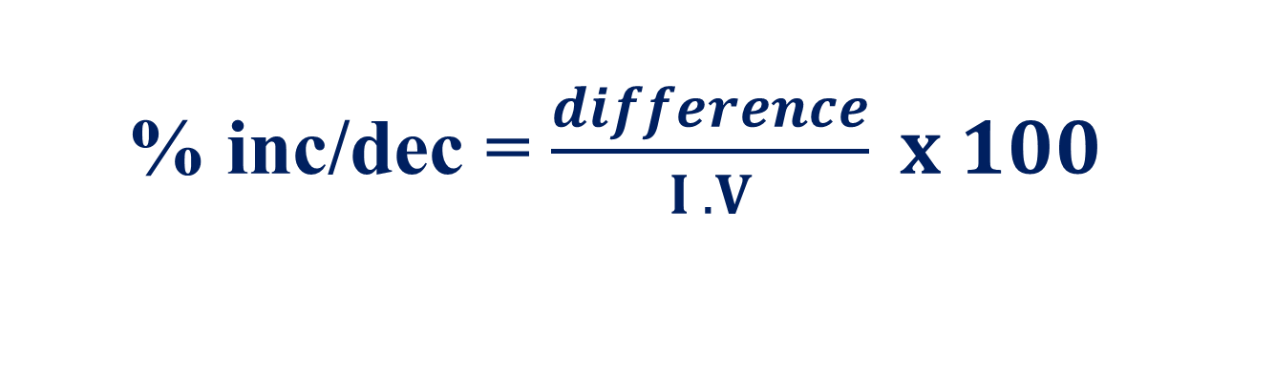

% inc/dec = $\frac{difference}{I .V} x 100$
% comparison = $\frac{d}{ Than} x 100$

