Slide 1

Speed, Time & Distance
Q-A

Slide 2

Prabhat covers a distance in 40 min if he drives at a speed of 60km/h on an average. Find the speed at which he must drive at to reduce the time of journey by 25%?
Salabh, during his journey, travels for 20min at a speed of 30km/h, another 30 min at a speed of 50km/h, next 1hr at a speed of 50km/h and last 1hr at a speed of 60km/h. What is average speed of entire journey?
The diameter of a cycle wheel is 70cm. A cyclist takes 30hr to reach a destination at a speed of 22km/h. How many revolutions will the wheel make during the journey?
A man traveled a distance of 61kms in 9hr . Partly on foot at the rate of 4kms per hour and partly on bicycle at the rate of 9kms per hour .Find the distance travelled on the foot.

Slide 3

Prabhat covers a distance in 40 min if he drives at a speed of 60km/h on an average. Find the speed at which he must drive at to reduce the time of journey by 25%?
Ans : d = 60 * 2/3 = 40km
so, 80 * ½ = 40
Salabh, during his journey, travels for 20min at a speed of 30km/h, another 30 min at a speed of 50km/h, next 1hr at a speed of 50km/h and last 1hr at a speed of 60km/h. What is average speed of entire journey?
Ans : 1 * 30 + 1 * 50 + 1 * 50 + 1 * 60
3 2
10 + 25 + 50 + 60 :. 145 = 145 * 6 = 51.18km/h
17 17 17
6 6

Slide 4
The diameter of a cycle wheel is 70cm. A cyclist takes 30hr to reach a destination at a speed of 22km/h. How many revolutions will the wheel make during the journey?
Ans : d 1-rev = ∏d
= 22/7 * 70
= 220cm
d Actual-rev = 22 * 30 = 660km
= 660000m
:. 66000000 / 220 = 3 lakh

Slide 5
ANS: part I (S=4) part II (S=9)
d = 61
part I (T=x) part II (T=y)
x+y = 9 hr
4x+9y=61
(4x+9y=61)- (4x+4y=36)
solving, 5y=25
y = 5
x = 4
d’foot =4*x= 16
4 . A man traveled a distance of 61kms in 9hr . Partly on foot at the rate of 4kms per hour and partly on bicycle at the rate of 9kms per hour .Find the distance travelled on the foot.

Slide 6

5. Walking at 4kms per hour ,a clerk reaches his office 5 minutes late . If he walks at 5kms per hour ,he will be 2 ½ minutes early. Find the distance from his office from his house.
6. A train running between two towns arrives at its destination 10 minutes late when it goes 60km per hour and 16 minutes late when it goes 40km per hour. Determine the distance between the two towns.
7. Two trains of equal lengths are running on parallel lines in the same direction at the rate of 46km/h and 36km/h. The faster train passes the slower train in 36 seconds. The length of each train is:

Slide 7

5. Walking at 4kms per hour ,a clerk reaches his office 5 minutes late . If he walks at 5kms per hour ,he will be 2 ½ minutes early. Find the distance from his office from his house.
Ans : S1 /S2 = T2/T1
4/5 = (T – 2.5 )/ T+5
lhs gap 1 = (7.5)rhs gap
lhs num 4→30 (effective rhs num)
rhs num is……. T2 →30 (1/2 hr)
d = S2T2 = 5X ½ = 5/2

Slide 8
Walking at 4kms per hour ,a clerk reaches his office 5 minutes late . If he walks at 5kms per hour ,he will be 2 ½ minutes early. Find the distance from his office from his house.
Lcm of s=d
Lcm 4,5=20
T1=5,t2=4….Td=1hr
Assumed domain tg=60 min….assumed domain d=20(f=3)
Actual domain tg=7.5 with f=3….ans 2.5

Slide 9
6. A train running between two towns arrives at its destination 10 minutes late when it goes 60km per hour and 16 minutes late when it goes 40km per hour. Determine the distance between the two towns.
Ans S1 /S2 = T2 /T1
60/40 =(T+16)/ (T+10)
20 → 6
40 = 12
T1 = 12 min
d = S1T1 = 60 X 12/60 = 12 km

Slide 10
7. Two trains of equal lengths are running on parallel lines in the same direction at the rate of 46km/h and 36km/h. The faster train passes the slower train in 36 seconds. The length of each train is:
Ans :
36 = x + x
10 * 5/18
= 1800 = 2x
18
:. 50 = x

Slide 11
8. Two trains are running at a speed of 50kms/hr and 30kms/hr respectively in the opposite direction. The train running at 50kms/hr crosses a man in the other train in 18 seconds . Find the length of the fast train .
9. A man can row 6km/h in still water. It takes him twice as long to row up as to row down the river. Find the rate of stream.
10. The driver of a car driving at the speed of 38kms/hr locates a bus 40m head of him .After 20 seconds the bus is 60 m behind . Find the speed of the bus .
11. A man can row 30km upstream and 44km downstream in 10hr. It is also known that he can row 40km upstream and 55km downstream in 13hr. Find the speed of the man in still water.

Slide 12

8 ) Two trains are running at a speed of 50kms/hr and 30kms/hr respectively in the opposite direction. The train running at 50kms/hr crosses a man in the other train in 18 seconds . Find the length of the fast train .
Ans Tp =[ Lt +Lo (0)]/Sr
18 = Lt /( 80 X 5/18 )
18X 80 X 5/18 = Lt
400 = Lt

Slide 13
9. A man can row 6km/h in still water. It takes him twice as long to row up as to row down the river. Find the rate of stream.
Ans Tu/Td = 2/1
Su = 1x
Sd = 2x
Sb = Su + Sd
2
6 = 3x (4,8)
2

Slide 14
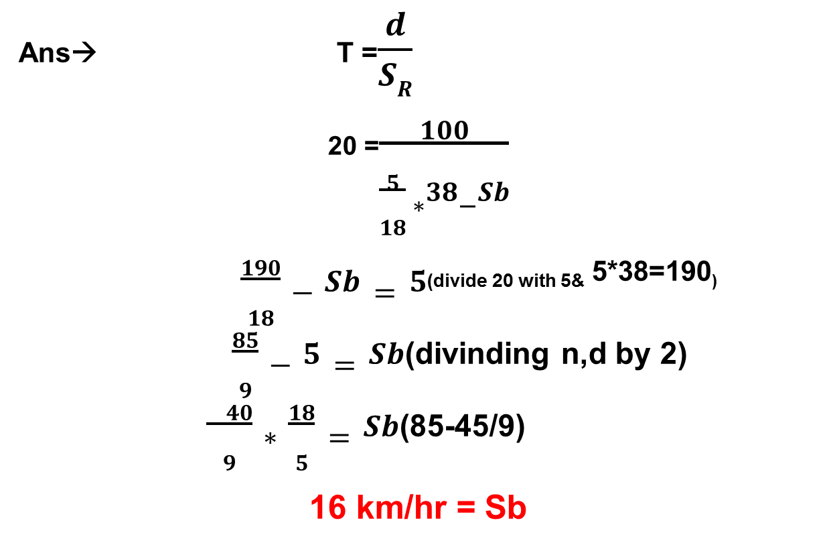
10). The driver of a car driving at the speed of 38 kms/hr locates a bus 40m head of him .After 20 seconds the bus is 60 m behind . Find the speed of the bus .
Ans→ T =$\frac{d}{SR}$
₂₀ ₌$\frac{100}{\frac{5}{18} ∗38−Sb}$
$\frac{190}{18}−Sb=5$_{(divide 20 with 5&} 5*38=190₎
$\frac{85}{9}−5=Sb$_{(divindingn,d by 2)}
$\frac{ 40}{9}∗\frac{18}{5}=Sb$_{(85-45/9)}
16 km/hr = Sb

Slide 15
11. A man can row 30km upstream and 44km downstream in 10hr. It is also known that he can row 40km upstream and 55km downstream in 13hr. Find the speed of the man in still water.
Ans: 30/u + 44/d = 10
30a + 44b = 10……(1)
40a + 55b = 13……(2)
7.5a + 11b = 2.5….(3)
- 8a + 11b = 2.6…….(4)
0.5a = 0.1
a = 1/5
b = 1/11………….put in (1)
u = 5
d = 11
b = 11 + 5 = 8km/h
2

Slide 16
12. Two cars start from one point and move along two roads at right angle. If theirs speed be respectively 36kms/hr and 48km/hr, find the distance between them 15 seconds after the start.
13. A monkey climbing up a greased pole ascends 12 meters and slips down 5 meters in alternate minutes . If the pole is 63km high , how long it will it take for him to reach the top ?
14. A hare sees a dog 100 meters away from her and scuds off in the opposite direction at a speed of 12km an hour . A minute later the dog perceives her and gives chase at a speed of 16km per hour. How soon will the dog overtake the hare, and at what distance from the spot whence the hare took flights ?
15. A train without stoppages travels on an average 50km an hour and with stoppages 40kms an hour .Prove that the train stops on an averages 12 minute per hour.

Slide 17
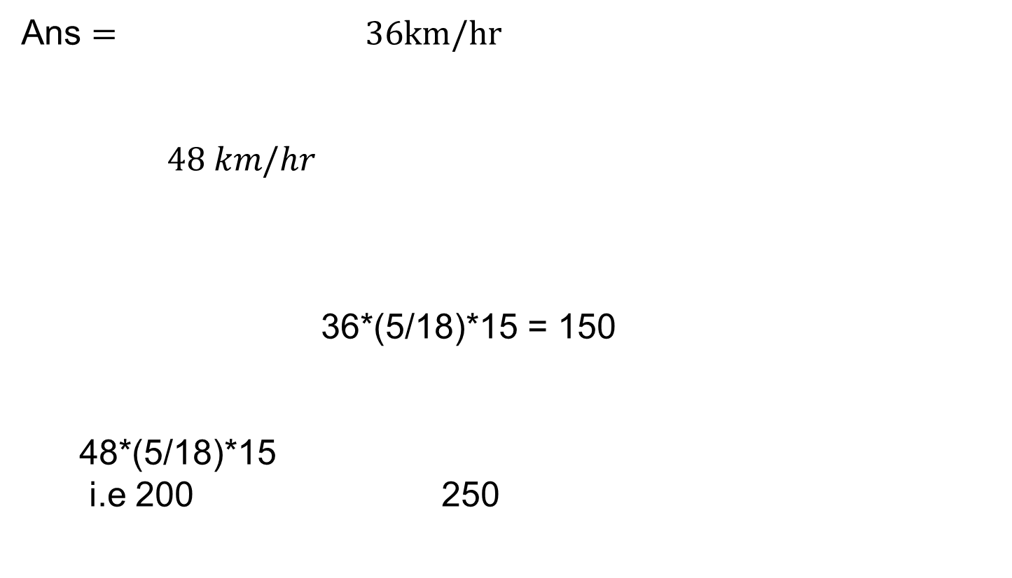
12. Two cars start from one point and move along two roads at right angle. If theirs speed be respectively 36 kms /hr and 48km/ hr, find the distance between them 15 seconds after the start.
Ans $= 36km/hr$
$$48 km/hr$$
36*(5/18)*15 = 150
48*(5/18)*15
i.e 200 250

Slide 18

13. A monkey climbing up a greased pole ascends 12 meters and slips down 5 meters in alternate minutes . If the pole is 63km high , how long it will it take for him to reach the top ?
Ans : 1 +12
2 -5 7
3 +12
4 -5 7
For alternate work having –ve
go for 2nd last step
Here ideally we should have 63/7 steps but 2nd last step will be 8th so corresponding work will be 56 which will take 16 minutes.
T W
2 7
16 56
17 minute work will be climbing where in In 60 sec 12 meter so for 7m 35 sec :. Final ans: 16 m 35 s

Slide 19

14). A hare sees a dog 100 meters away from hare scuds off in the opposite direction at a speed of 12 km/hr. A minute later the dog perceives hare and gives chase at a speed of 16 km/hr. How soon will the dog overtake the hare, and at what distance from the spot whence the hare took flight?
Ans : 12km/hr 16 kmph
C.P. h₁ 200m h₀ 100m d₁
Initially:
d₁ = Dogs chasing point (reference motion point)
h₀ = Hare’s flight point
h₁ = Dog’s ref point
C.P. = Point where dos catches Here.
By the time dog starts chase, here has covered (12*5/18)*60 sec=200m
:. Effective distance d₁h₁ = 300
T = 0.3km/(16 -12 )
= (0.3/4)*60
= 4.5min
For second part we must know time of run of here from S₀ to C.P =5.5 min :. Required distance (5.5/60) * 12 = 1.1 km

Slide 20
15. A train without stoppages travels on an average 50km an hour and with stoppages 40kms an hour .Find the stoppage time per hour.
Without Stoppage
50 km 60 min
5 : 6
Without Stoppage
48 km 60 min
5 : 6
So 12 min stoppage/hr

