Slide 1

TCS Specific QUANTITATIVE APTITUDE (ANSWER)

Slide 2


ANSWERS
1. If (x+10)% of 240 is 60% more than x% of 180. then 15% of (x+20) is what percent less than 25% of x?
14 2) 191/21 3) 15 ½ 4) 16
ANSWER : (4) 16
Explanation : (x+10)240/100 = (60/100)(x180)+ (x180/100 ) 240x + 2400 = 108x +180x 2400 = 288x-240x 2400=48x x=2400/48 x=50 15% of (50 +20)=10.5 25% of 50=12.5 Difference=12.5-10.5=2 Hence required %=(2100/12.5) = 16%
2. The population of a town is 1,21,000 if it increases at the rate of 10% per annum, what is the difference between the population 3 years hence and that of 2 year ago​?
62041 2) 61055 3) 61251 4) 61051
ANSWER : (4) 61051
Explanation : Given population of a town is 1,21,000 Population 3 years hence = 1,21,000×110/100×110/100×110/100 = 161051 Population 2 years ago = 1,21,000×100/110×100/110 = 100000 Difference =161051-100000 =61051
3. If two numbers are, respectively, 25% and 40% less than the third number, what is the ratio of these two numbers?
3:4 2) 3:5 3) 4:5 4) 5:4
ANSWER : (4) 5:4
Explanation : Let us assume that the third number is equal to 100x. So , First number = 25% less than the third number = 75% of third number = (75 * 100x)/ 100 = 75x and , Second number = 40% less than the third number = 60% of third number = (60 * 100x)/100 = 60x then, First number: Second number = 75x: 60x First number: Second number = 5:4

Slide 3
ANSWERS
4. Pawan visits his friend's home, which is 20 km away from his home. He covers the first half of the distance at the speed of 6 km/h and to cover the second half of the distance le takes double the time than the first half. What is the time taken by him to cover the whole journey?
320 minutes 2) 300 minutes 3) 240 minutes 4) 280 minutes
ANSWER : (2) 300 minutes
Explanation : Total time = Time Taken to complete the first half + Time Taken to complete the second part.
Time Taken to complete the first half = (10Km/6Kmph) * 60 Minutes = 100 Minutes
Time Taken to complete the second part.= 2 * Time Taken to complete the first half = 2 * 100 = 200 Minutes
Total time taken to complete the whole journey = 300 minutes
5. Manoj travelled one third of a distance at an average speed of 16 km/hr then half of distance at a speed of 15Km/hr and covered the rest of distance at an average speed of 20km/hr.If he took total of 15 hours in completing the journey then total distance covered by him is​
205Km 2) 250Km 3) 240Km 4) 230Km
ANSWER : (3) 240 km
Explanation : Answer should be highly likely a multiple of 6 (only one option in the answer choices satisfies the condition) , because while processing 1/3rd and ½ , denominator will be 6 , only if the total value is a multiple of 6 we will be getting integral values for time and that’s the reason we assumed the distance to be 6x.

Slide 4
ANSWERS
6. The length of a rectangle is 48 m and its perimeter is 150 m. What will be the perimeter of a square whose area is equal to this rectangle?
123 m 2) 144 m 3) 121 m 4) 160 m
ANSWER : (2) 144 m
Explanation : Given perimeter & length , from this we can find breadth
breadth = (150-2*48)/2=27 ; Area of rectangle = 27×48 =1296=Area of square
√1296= side of square = 36
Perimeter=36×4=144
7. A certain sum amounts to INR 9799 in 3 years and to INR 12464 in 8 years at a certain rate percent per annum, at simple interest. What will be the amount (in rupees) of the same sum in 5 years at double the earlier rate, at simple interest?
1) 12960 2) 13530 3) 13500 4) 12840
ANSWER : (2) 13530
Explanation : Let the Principal = P
The problem is of simple interest
So, interest of a certain principal amount with same rate of interest per year will be same
Let Interest per year = I Now by the first condition P+3I = 9799—------------(1)
Again by the second condition P+8I = 12464—------------(2)
Equation (2) - Equation (1) gives I = 533,From Equation (1) P = 9799 - (3*533) ; P = 8200 P + (2*5)I = 8200 + 5330 = Rs13530

Slide 5
ANSWERS
8. In how many ways can we give change for Rs 50 using 1 rupee and 2 rupee coins? For example for 5 rs we can give it in three ways(1,1,1,1,1) (1,1,1,2) )(1,2,2)
100 2) 50 3) 51 4) 99
ANSWER : (3) 51
Explanation : Possibility 1 - 50 - 2Rs Coin & 0 - 1Re Coin
Likewise we can reduce the number of 2 rupee coins one by one and adjust it with 1 rupee coins. In that way the number of 2 rupee coins can range from 50,49,48 … upto 0.
That gives us a total of 51 possibilities.
9. The index numbers of five commodities are 121, 123, 125, 126, 128 and the weights assigned to these are respectively 5, 11, 10, 8, 6. Then what is the weighted average index number?
123.8 2) 124.2 3) 124.6 4) 125.2
ANSWER : (3) 124.6
Explanation : Weighted average = Summation of the product of Index and Weights / Summation of Weights
Summation of the product of Index and Weights = 1215 + 12311 + 12510 + 1268 + 128*6
= 605 + 1353 + 1250 + 1008 + 768 = 4984
Summation of Weights = 5 + 11 + 10 + 8 + 6 = 40
Weighted average = 4984 / 40 = 124.6

Slide 6
ANSWERS
10. A retailer purchased 25 identical toys for a price of Rs P and sold some of them for Rs P. If he calculated his profit as 8%, with selling price as base instead of cost price then how many did he sell?
24 2) 20 3) 21 4) 23
ANSWER : (4) 23
Explanation : Let's assume the selling price as 100 then his profit will be 8 Rs and CP will be 92 Rs . Since the total amount he received is same P , the profit will be proportional to the number of objects sold.
100/92 = 25/x
X = 23
So, the number of objects sold is 23.
11. What will be smallest fraction form of 0.0056
7/1275 2) 7/1250 3) 7/1175 4) 7/1150
ANSWER : (2) 7/1250
Explanation : Fraction form of 0.0056 = 0.0056 / 1
Multiplying 1000 in numerator and denominator
(0.0056 x 10000)/(1 x 10000)
56/10000 (divide both numerator and denominator by 8)
7/1250

Slide 7
ANSWERS
12. What decimal of an hour is a second
1) .0028 2) .00027 3) .0026 4) .0025
ANSWER : (2) 0.00027
Explanation : In one hour =1/(60×60)=1/3600 sec =.00027 sec
13. A mixture of certain quantity of milk with 16 litres of water is worth 90 paise per litre. If pure milk be worth RS 1.08 per litre, how much milk is then there in the mixture
1) 75 2) 80 3) 65 4) 60
ANSWER : (2) 80
Explanation : let the mixture contain 'x' lit of milk and already given 16lit of water
as water don't cost (x+16) lit of mixture = x lit of pure milk
(x+16)90=(x*1.08*100) /*since given in paise*/
x=80 litres
14. The average age of 10 students and their teacher is 15 years. The average age of the first seven students is 15 yr and that of the last three is 11 yr. What is the teacher's age?
1) 33 years 2) 30 years 3) 24 years 4) 27 years
ANSWER : (4) 27 years
Explanation : Total Age of 10 students and Teacher = 11 x 15 = 165
Total age of first 7 students = 7 x 15 = 105
Total age of 3 students = 3 x 11 = 33
Thus total age of students = 33 + 105 = 138 ; Age of Teacher = 165 - 138 = 27

Slide 8
ANSWERS
15. The present ages of Aman and Nina are 59 and 37 years, respectively. What was the ratio of the ages of Nina and Aman 13 years ago?
2:3 2) 12:23 3) 46:25 4) 8:3
ANSWER : (2) 12:23
Explanation : Since its 13 years ago
Nina's 13 year ago age = Present age - 13 = 37 - 13 = 24
Aman 13 year ago age = Present age - 13 = 59 - 13 = 46
Ratio = 24464624​ = 12:23
16. Consider the sequence 1,-2, 3,-4, 5,-6, ….. , what is the average of the first 2000 terms of the sequence?
-1/2 2) 1/2 3) -1/16 4) -1/8
ANSWER : (1) -1/2
Explanation : (1,3,5,..1999) here n=1000
s1=n/2(2a+(n-1)d)=10000000
(-2,-4,-6...,-2000) here n=1000
s2=-1001000
so avg term= s1+s2/2000term
= -1000/2000
= -1/2 ans.

Slide 9
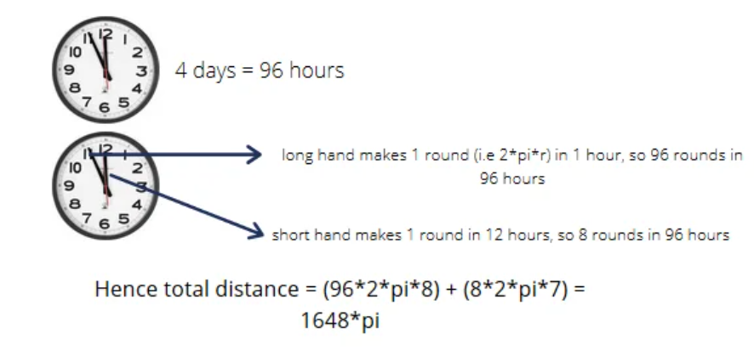
ANSWERS
17. The price of a commodity(in rupees per kilogram) is 100 + 0.1n, on the nth day of 2007 (n = 1, 2,….., 100), and then remains constant. On the other hand, the price of another commodity (in rupees per kilogram) is 89 + 0.15n, on the nth day of 2007 (n=1,2, …, 365). On which date in 2007, will the price of these two commodities be equal?
april 10 2) april 11 3) may 20 4) may 21
ANSWER : (3) may 20
Explanation :
100 + 0.1*100 =110
110 = 89 + 0.15n
solving this
n = 140 days
which is 20th of may
18. In a clock the long hand is of 8cm and the short hand is of 7cm. if the clock runs for 4 days find out the total distance covered by both the hands?
1824π cm 2) 1724π cm 3) 1648π cm 4) 2028π cm
ANSWER : (3) 1648 π cm
Explanation :

Slide 10
ANSWERS
19. In a particular year, the month of January had exactly 4 Thursdays , and 4 Sundays . On which day of the week did January 1st occur in the year?
Wednesday 2) Tuesday 3) Monday 4) Thursday
ANSWER : (3) Monday
Explanation : If a month has 31 days, and it starts with Sunday , Then Sundays,
Mondays, Tuesdays are 5 for that month. If this month starts
with Monday , then Mondays , Tuesdays , and Wednesdays
are 5 and remaining days are 4 each. So, this month start with Monday.
20. The famous church in the city of Kumbakonam has a big clock tower and is said to be over 300 years old. Every Monday 10.00 A M the clock is set by Antony, doing service in the church. The Clock loses 6 minutes every hour. What will be the actual time when the faulty clock shows 3 P.M on Friday?
Saturday 1.06 am 2) 4:54 am Friday 3) 2:13:20 am Saturday 4) 3 am Friday
ANSWER : (1) Saturday 1.06 am
Explanation : Let us start from Monday 10 am to Friday 3.00 pm.....total hours=
4 days 5 hrs.=4*24+5=101 hrs.
so total time loses=101*6 minutes=606 minutes=606/60=10 hrs 6 minutes
so actual time= Friday 3.00 pm + 10 hrs 06 minutes= Saturday 1.06 am.
Now, in most of the places they are giving answers as 4.54 AM, which is incorrect. As the clock loses 6 mins. Thus, we have to add the time.

Slide 11
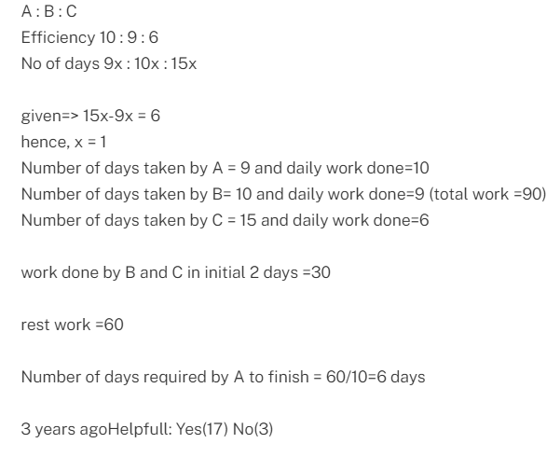
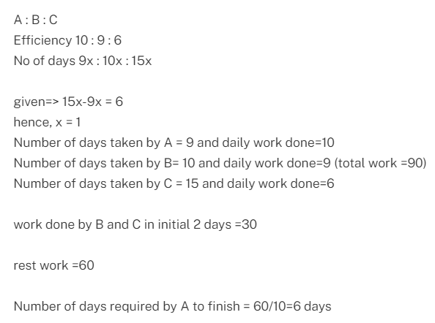
ANSWERS
21. The ratio of efficiency of A is to C is 5:3.The ratio of no.of days taken by B is to C is 2:3.A takes 6 days less than C, when A and C completes the work individually. B and C left the work after 2 days. the no of days taken by A to finish the remaining work?
28/3 2) 5 3) 6 4) 4.5
ANSWER : (3) 6
Explanation :

Slide 12
ANSWERS
22. Y can do a work in 2/3 the time it takes x, z can do same work in ¾ time it takes y. when all three are typing the same time what is the fraction of total work does y do?
1) 1/3 2) 8/29 3) 4/13 4) 9/23
ANSWER : (3) 4/13
Explanation : as per data.. Y=2/3x---- (1) and Z=3/4Y----(2)
and they all type the same time X+Y+Z=1----(3)
and from equations (1) and (2) substitute interms of Y in eq (3)
3/2Y+Y+3/4Y=1
(6Y+4Y+3Y)/4=1
13Y/4 =1
Y=4/13
therefore. answer is Y=4/13
23. Jake and Paul each walk 10 km. The speed of Jack is 1.5 faster than Paul's speed. Jack reaches the destination 1.5 hours before Paul. Then Jake's speed is equal to?
4 2) 6 3) 8 4) 2
ANSWER : (1) 4
Explanation :Let the speed of Jake = x kmph
So, speed of Paul = ( x - 1.5 ) kmph
Time difference =1.5hours
Total Distance = 10km
10/(x-1.5) -10/x = 1.5
By solving the above eq. x = 4 kmph

Slide 13
ANSWERS
24. A bus leaves Mumbai at 3 pm. It travels for 1.5 hours at 60km/hr and then halts for 30 minutes. It then travels at an average speed of 50km/hr for the remaining duration to reach Pune at 6pm. What is the distance between Mumbai and Pune?
140 km 2) 110 km 3) 120 km 4) 100 km
ANSWER : (1) 140 km
Explanation : bus covered a distance in (1.5 hour and 30 min. halt) 2 hour is =
1.5*60 = 90 km
remaining time to reach Pune is only 1 hour then bus travels with the speed of
50km/h
now remaining distance = 1*50 = 50 km
now total 50+90 = 140 km
25. Ajay, Ramya, Suresh and Mary are at one end of a bridge. It is pitch dark and they have only one torch light. They need to get to the other side and have to carry the torch. Ajay can cover the distance in 1 minute, Suresh in 2 minutes, Ramya in 5 minutes MARY takes 10 minutes?
20 mins 2) 17 mins 3) 22 mins 4) 18 mins
ANSWER : (2) 17 mins
Explanation : (1) & (2) Cross with Torch 2
(1) Returns with Torch 1
(5) & (10) Cross with Torch 10
(2) Returns with Torch 2
(1) & (2) Cross with Torch 2 TOTAL 17

