Slide 1



Slide 2
Percentage Conversion Table:-
½ | 50 %
1/3 | 33.33 %
¼ | 25 %
1/5 | 20 %
1/6 | 16.66 %
1/7 | 14.28 %
1/8 | 12.5 %
1/9 | 11.11 %
1/10 | 10 %
1/11 | 9.09 %
1/12 | 8.33 %
1/13 | 7.69 %
1/14 | 7.14 %
1/15 | 6.66 %
1/16 | 6.25 %
44% = 4*11% = 4/9
21% = 7% *3
= 1/14 * 3 = 3/14
22% = 2*11%
=2/9
27% = 3/11
66% = 2/3
14% = 2/7
¾ | 75 %
½ | 50 %
3/8 | 37.5 %

Slide 3
What is the rise percentage?
% Rise = d/IV = 10/45
= 2/9
= 22%
By how much percentage IT is less than CSE?
1995 | 1996
45 | 55
CSE IT
32 42
% = 10/32
5/16
6.6 *5
= 33%

Slide 4
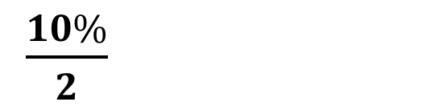
10% →
1 d less
1% →
2 d less
$\frac{10\%}{2}$
5% →
E.g. 1) 10% of 790 =
79
E.g. 2) 10% of 820 =
82
E.g. 3) 1% of 350 =
3.5
E.g. 4) 3% of 420 =
4.2 x 3 = 12.6
E.g 5) 15% of 540 =
10% + 5% = 54 + 27
= 81

Slide 5
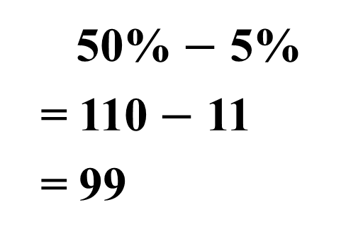
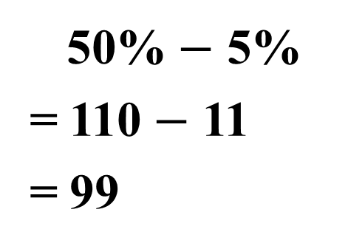
E.g → 30% of 720 =
72 x 3 = 216
E.g → 55% of 420 =
50% + 5%
= 210 + 21
= 231
E.g → 55% of 740 =
50% + 5%
= 370 + 37
= 407
E.g → 45% of 220 =
50% $−$ 5%
= 110 $−$ 11
= 99

Slide 6
QUIZ
20 % of 550 2) 40 % of 580 3) 70 % of 230
4) 5 % 450 5) 8 % of 380 6) 15 % of 180
7) 55% of 270 8) 55 % of 320 9) 45 % of 220
10) 45 % of 170
ANSWERS:
1) 110 2)232 3) 161 4) 22.5 5) 30.4
6) 27 7) 148.5 8) 176 9) 99 10) 76.5

Slide 7


½ | 50 %
1/3 | 33.33 %
¼ | 25 %
1/5 | 20 %
1/6 | 16.66 %
1/7 | 14.28 %
1/8 | 12.5 %
1/9 | 11.11 %
1/10 | 10 %
1/11 | 9.09 %
1/12 | 8.33 %
1/13 | 7.69 %
For more → $\frac{1}{n−1}$
For less → $\frac{1}{n+1}$
1) If A is 20 % more than B
B will be 16.66% less than A
2) X is 33.3% less than Y
Y will be 50 % more than X
3) P is 12.5% less than Q
Q will be 13.69% more than P
4) S is 10% less than R
R will be 11.1 % more than S

Slide 8
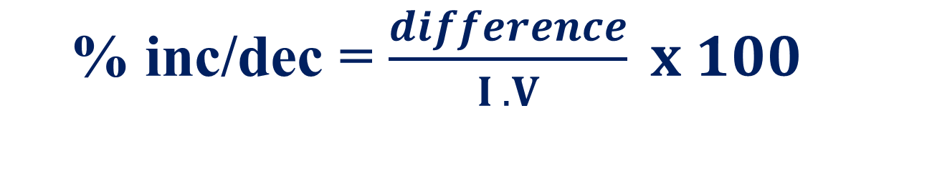

% inc/dec = $\frac{difference}{I .V} x 100$
% comparison = $\frac{d}{ Than} x 100$

Slide 9
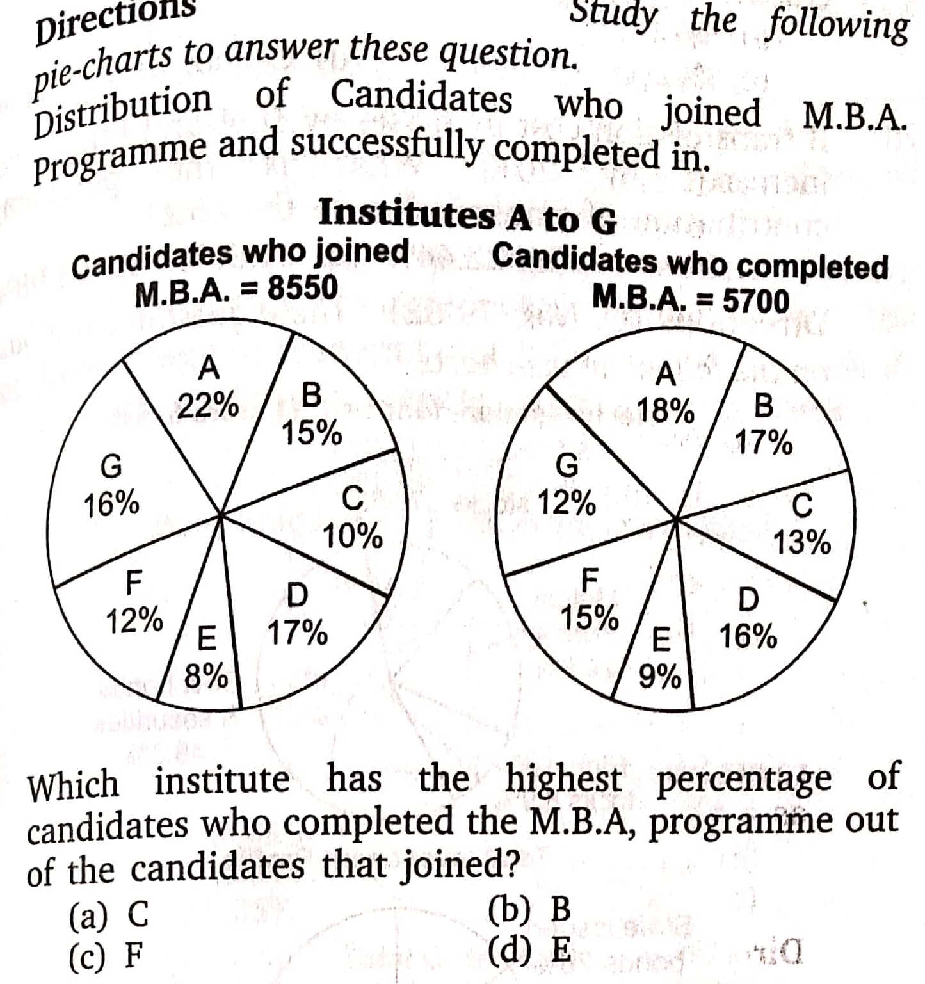
1.

Slide 10
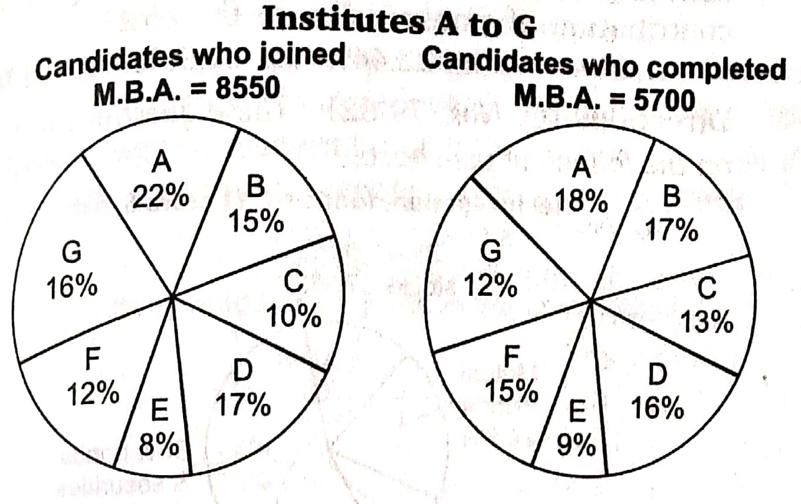
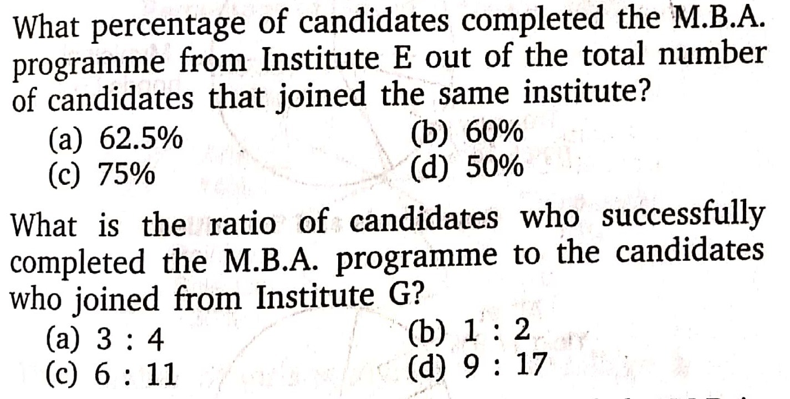
2.
3.

Slide 11
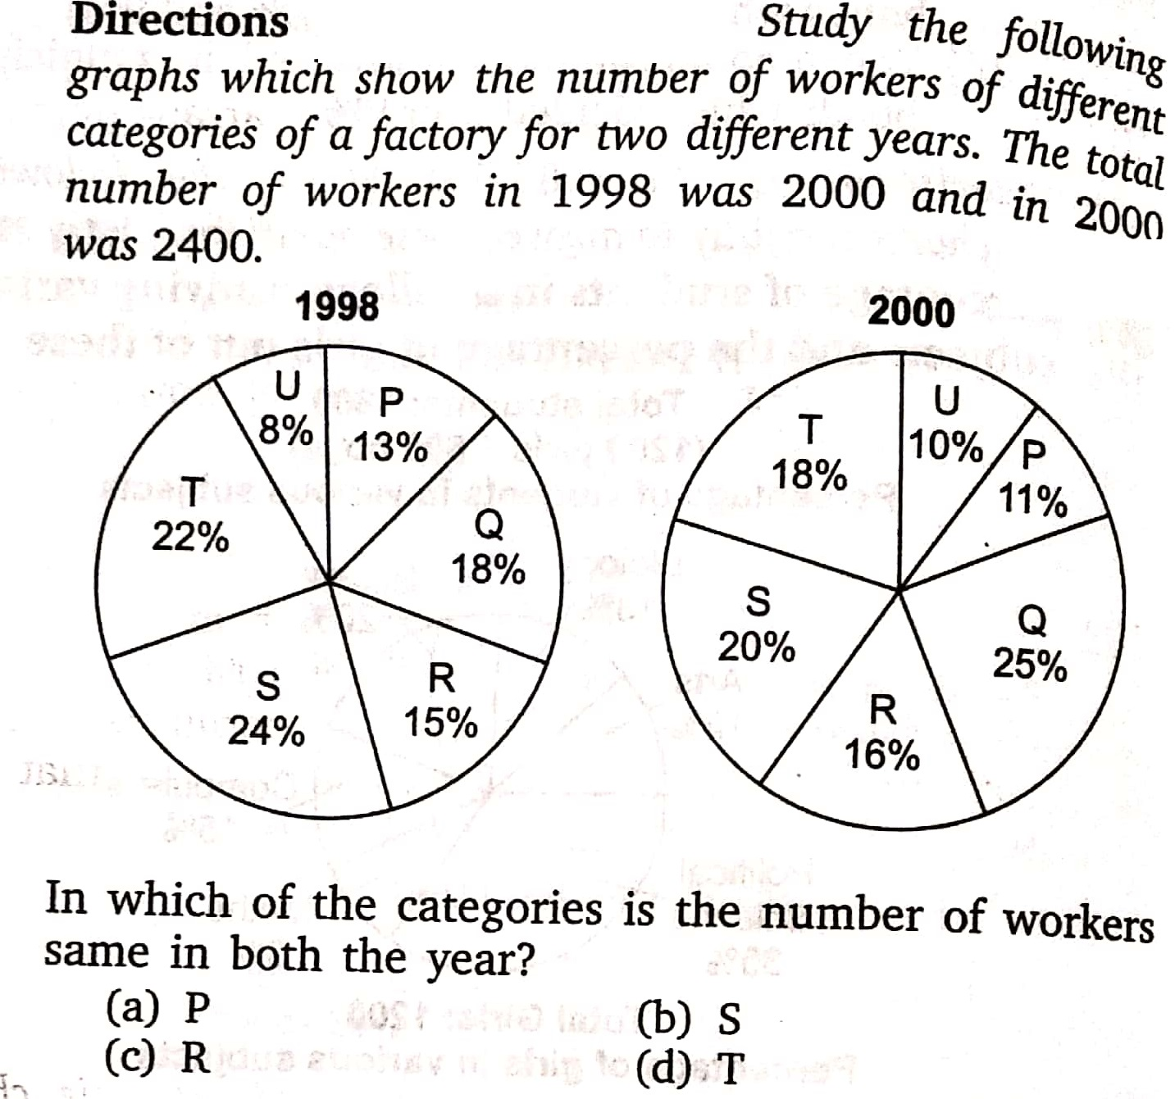
4.

Slide 12
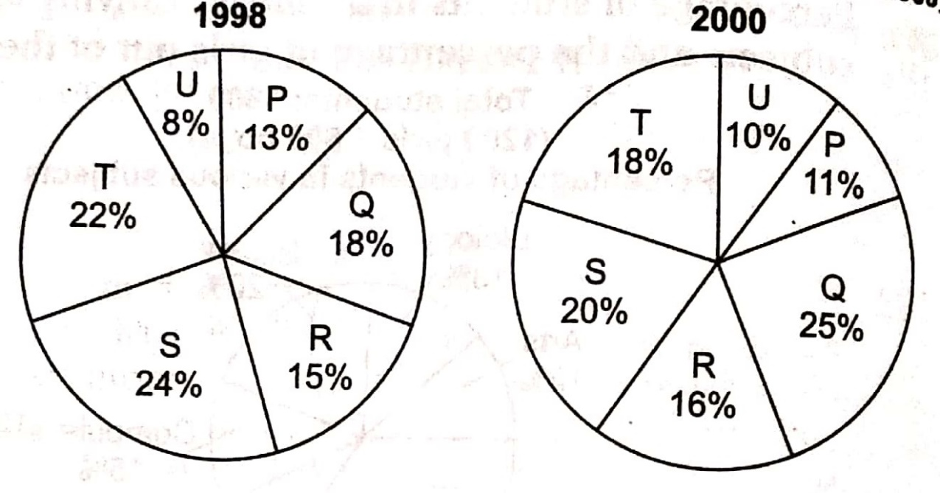
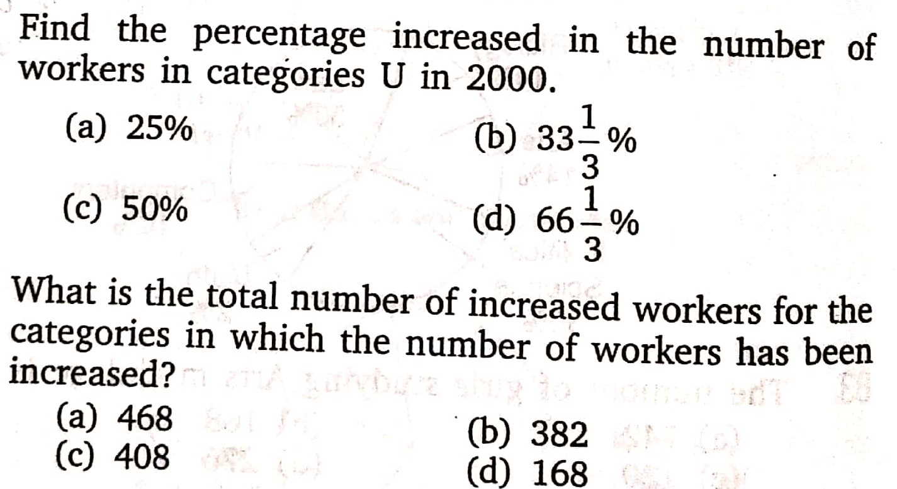
5.
6.

Slide 13
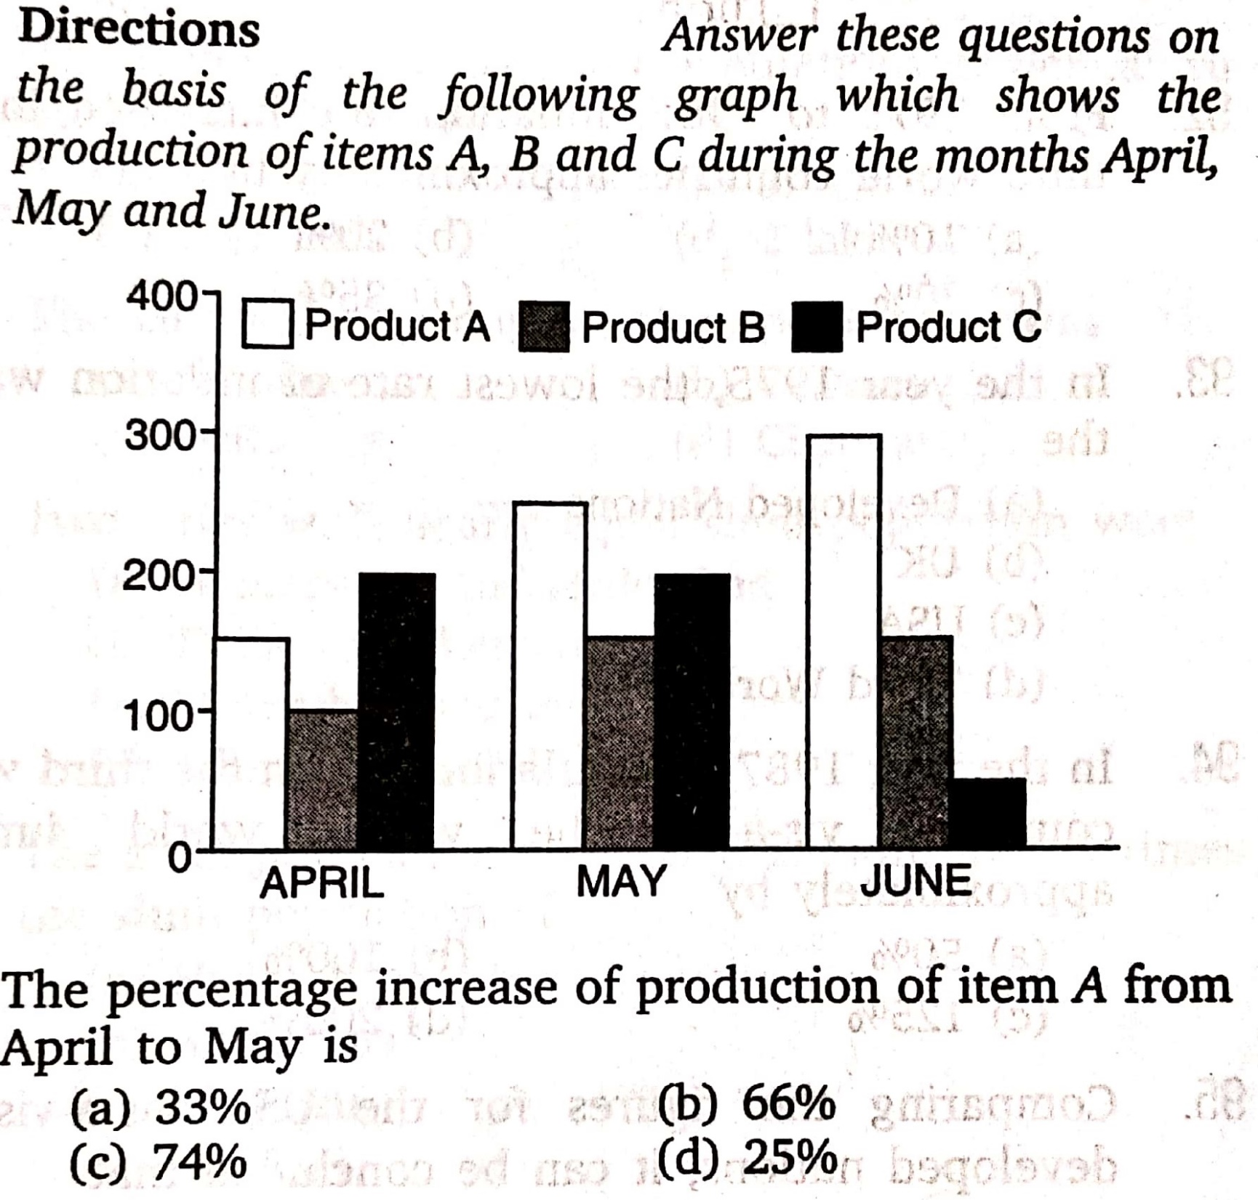
7.

Slide 14
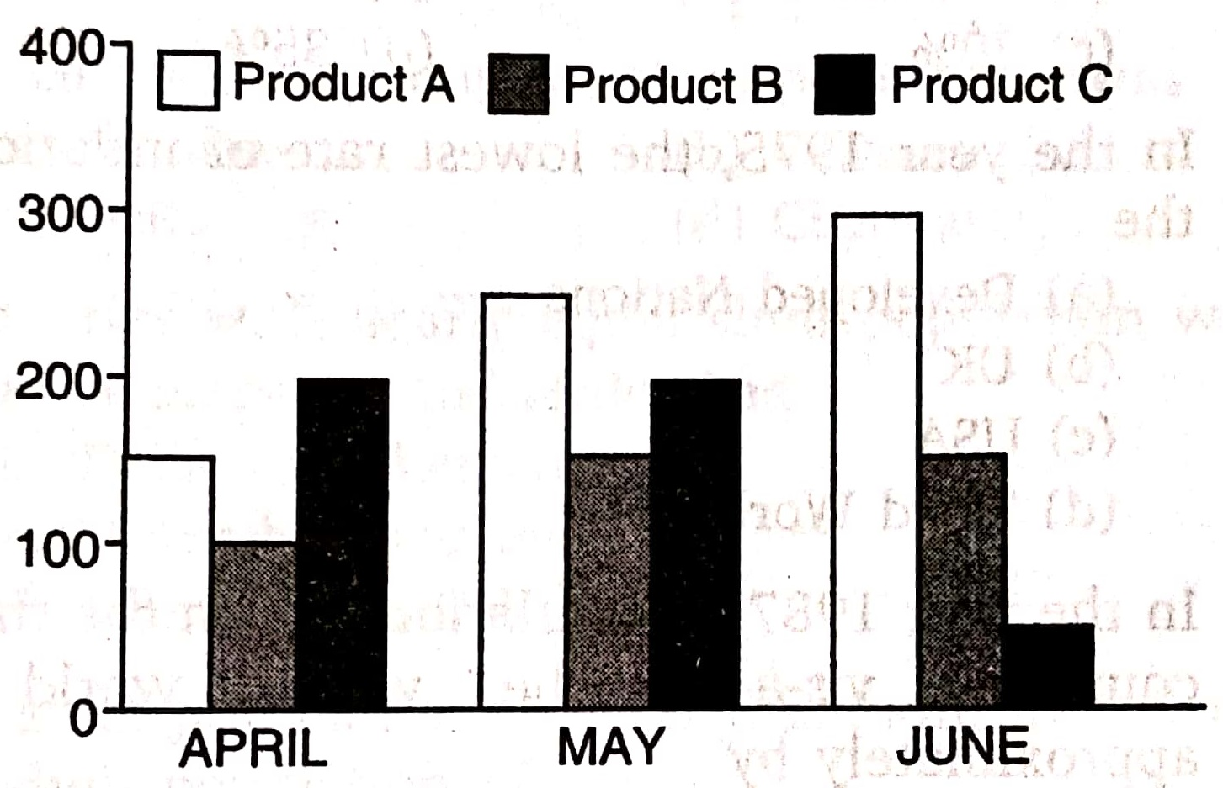
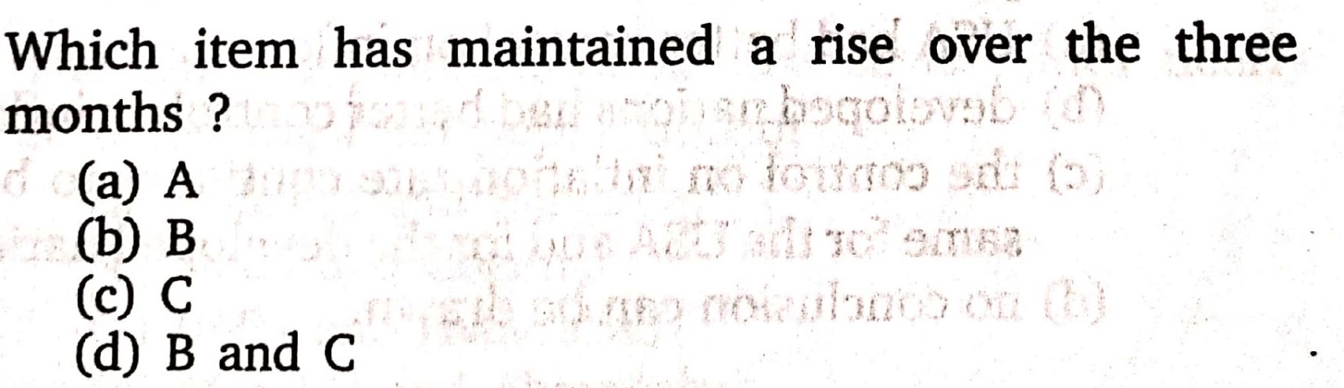
8.

Slide 15

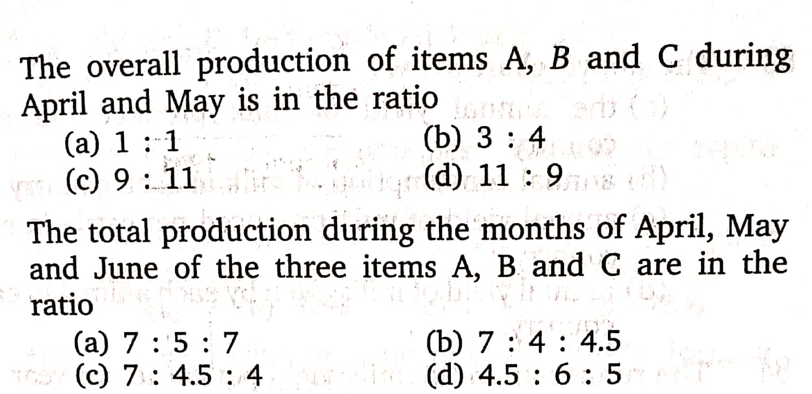
9.
10.

Slide 16
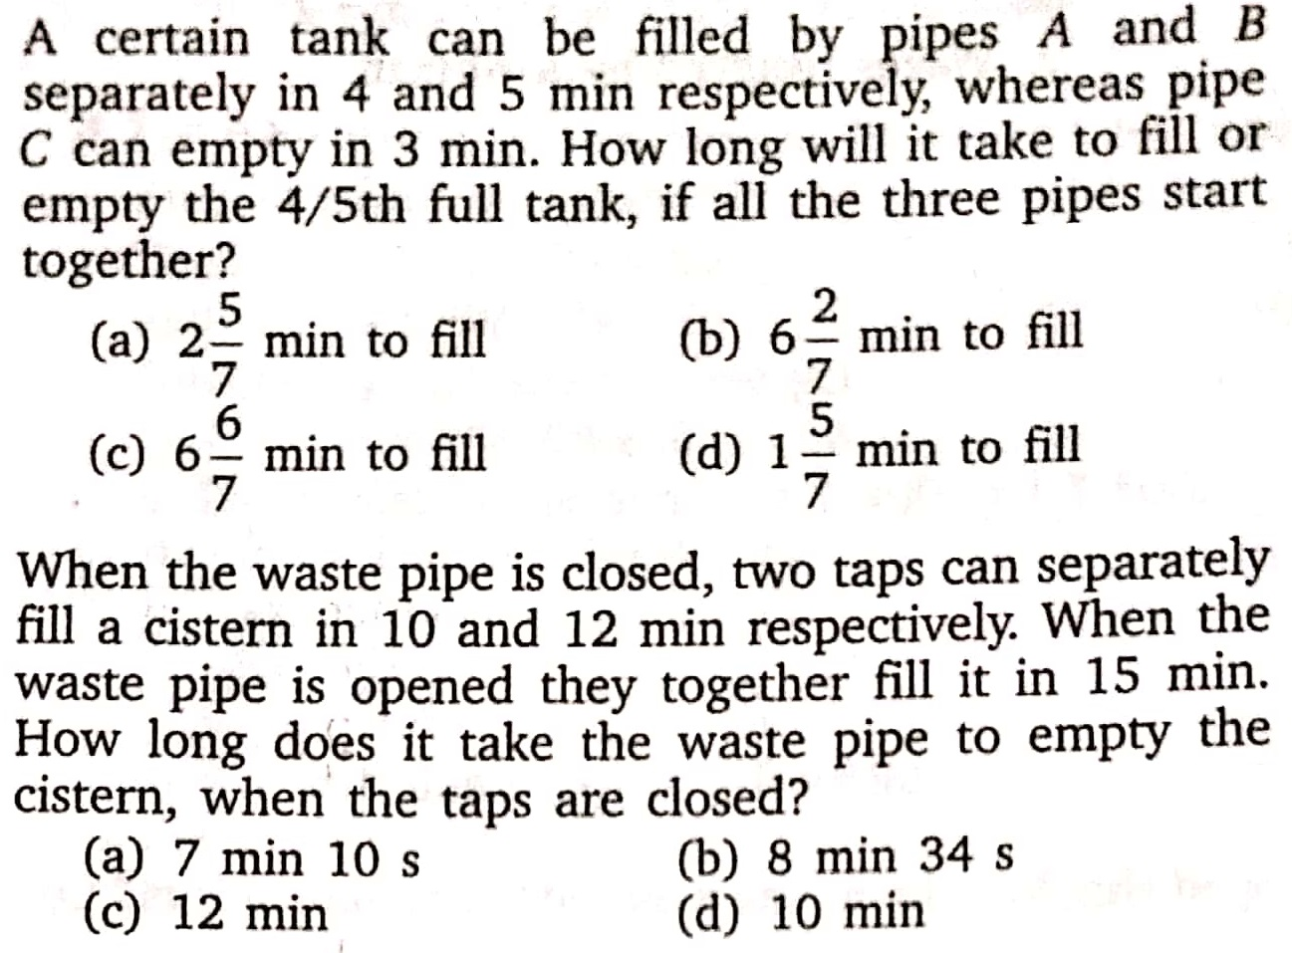
11.
12.

Slide 17
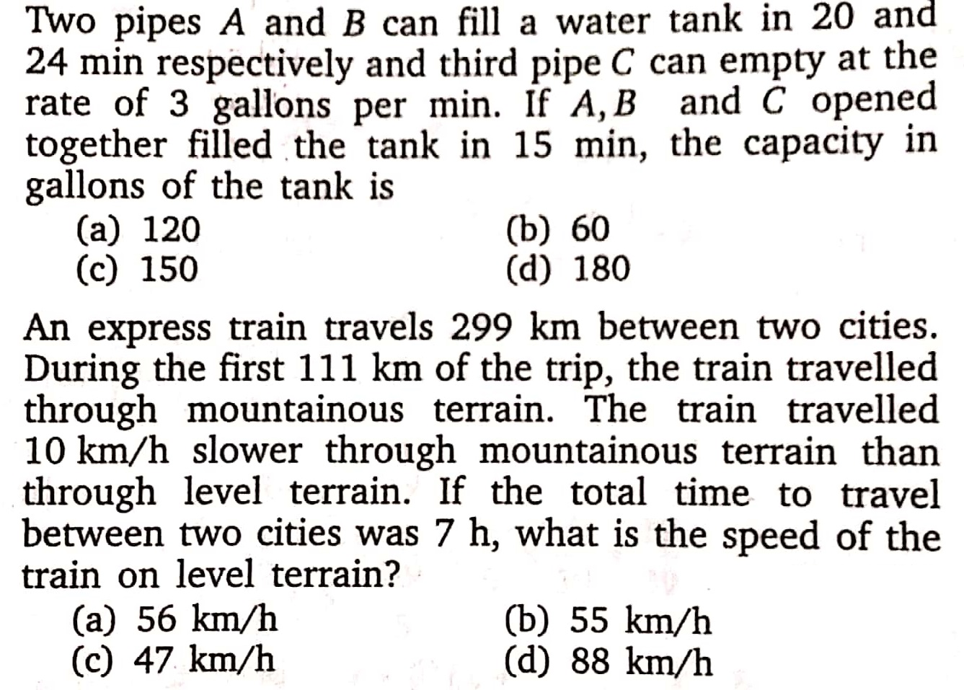
13.
14.

Slide 18
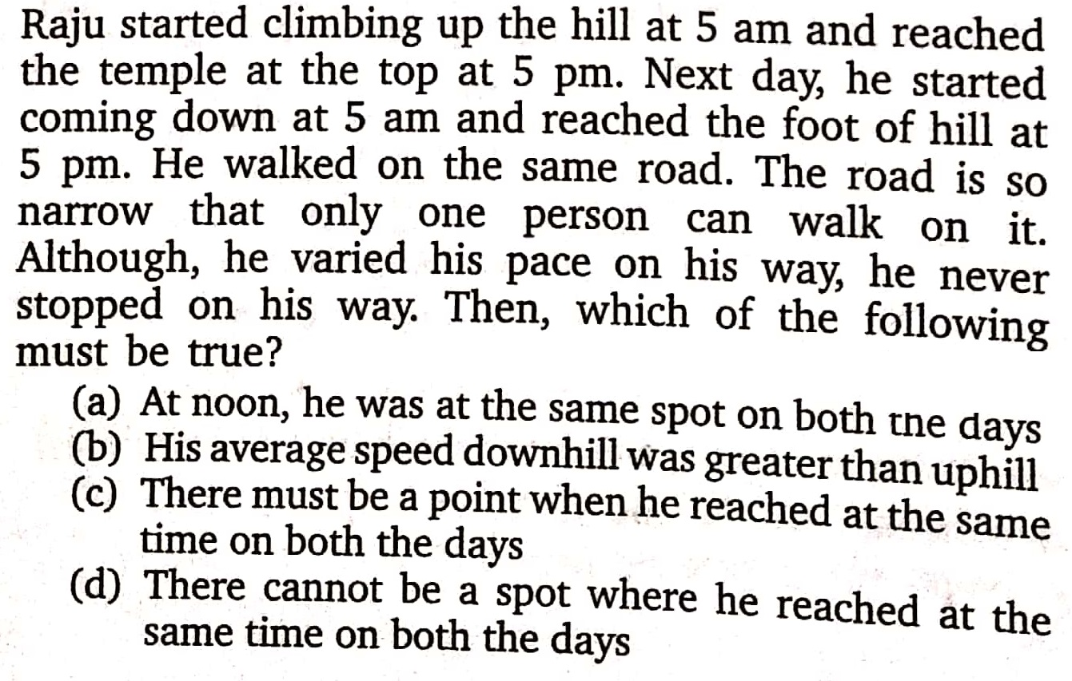
15.

Slide 19
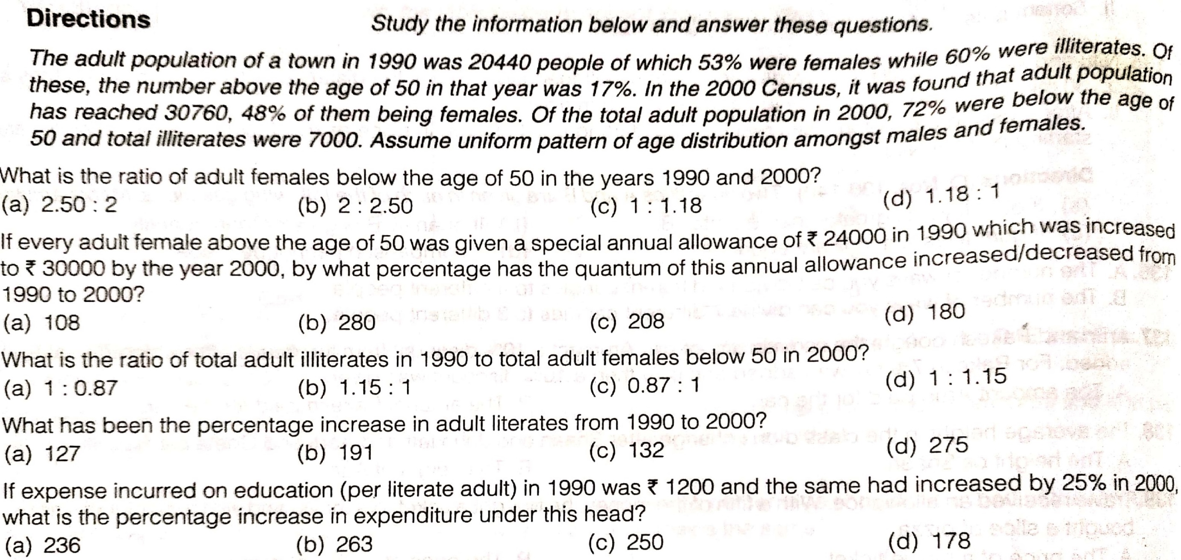
16.
17.
18.
19.
20.

