Slide 1


Slide 2

1. As ‘COUNSEL’ is to ‘BITIRAK’ so also ‘GUIDANCE’ is to
FOHYZJBB b) HOHYBJBA c) FPHZZKAB d) FORHYZJBB
2. If in a certain language, NEOMAN is coded as OGRQFT, which word will be coded as ZKCLUP
YIZHPJ b) XIAJSN c) YJBKTO d) YIAQKJ
3. In a certain code language, ‘ne ri so’ means ‘good rainy day’, ‘si ne po’ means day is wonderful’ and ‘ri jo’ means ‘good boy’. Which of the following means ‘rainy’ in the code
ne b) si c) ri d) so

Slide 3
4. In a certain code ROAD is written as URDG. How is SWAN written in that code
UXDQ b) VZDQ c) VXDQ d) VZCQ
5. If table is called chair, chair is called cot, cot is called pot and pot is called filter, where does a person sit
a) Pot b) Cot c) Chair d) Filter

Slide 4
6. From my house, I went towards North for 10 m, took left turn for 10m and walked taking right turn. In what direction was I going at that point
a) East b) South c) North d) West
7. A person goes 20m towards South, then turns left and goes 20m and another 20m to the left and then 60m to right. In which direction is he going now
a) North b) South c) East d) West
8. A man was walking with his face towards east. He walked 30m and then turned to his right by another 30m. He again turned towards his right by 60m. He now turned back 90m. Which direction was he facing now
a) Nprth b) South c) East d) West

Slide 5
9. From a point, Rajnish started walking towards east and water 35m. He then turned towards his right and walked 20m and again turned right and walked 35m. Finally he turned to his left and walked 20m and he reached his destination. Now, how far is he from the starting point
a) 50m b) 55m c) 20m d) 40m
10. Directional post is erected on a crossing. In a accident it was turned in such a way that the error which was first showing east is now showing south. A passerby went in a wrong direction thinking it is west. In which direction is he actually travelling now
a) South b) North c) East d) West

Slide 6
11. Kartik is the father of Heena, Uma is the mother of Tanya. The sister of Hina and Tanya is Neha. which of the following statement is definitely not true
a) Uma is the mother of Neha
b) Heena is the sister of Neha
c) Uma has three daughters
d) Tanya is the son of Kartik
12. Ramkrishna said, “This girl is the wife of the grandson of my mother.” How is Ramakrishna related to the girl
a) Father b) Father in law c) Grandfather d) Daughter in law

Slide 7
13. Showing a photograph to a friend Ravi says, “She is the grand-daughter of the elder brother of my father”. How is the girl related to ravi
a) Niece b) Sister c) Aunt d) Sister in law
14. Saroj is mother in law of Vani who is sister in law of Deepak. Rajesh is father of Ramesh, the only brother of Deepak. How is Saroj related to Deepak
a) Wife b) Aunt c) Mother in law d) Mother
15. When anuj saw Manish, he recalled “He is the son of the father of my daughter's mother”. Who is Manish to Anuj
a) Brother b) Brother in law c) Cousin d) Uncle

Slide 8
Direction (Q. No. 16 & 17) Answer the questions based on the information given below there are four friends namely Akshay, Bhushan, Chandrajeet and Dheeraj. Each person plays one outdoor game and has one hobby related to fine arts
Two persons are interested in cricket while the other two likes to play hockey
Two of these four persons are painters, one is a singer and the fourth one is a dancer
Akshay is neither a painter nor a Hockey player
Bhushan does not dance
The one who likes dancing, plays Hocky
Bhushan and Dhiraj don't play cricket
16. who amongst the following plays cricket and is interested in painting
Akshay b) Chanderjeet c) Bhushan d) Dhiraj
17. who among the following is a singer
a) Dhiraj b) Akshay c)Chandrajeet d) Bhushan

Slide 9
Direction (Q. No. 18 & 19) Study the information below to answer this questions
Seven types of paints A, B, C, D, E, F, & G of different colours red, green, yellow, black, blue, white and orange are field in different tins P, Q, R, S, T, U, & V.
The Order of the types of paints, colours and the tins is not necessarily in the same order
Paint B is not kept in tins Q or R and is white in colour
Paint D is kept in tin V and is not blue or red
Paint C & E are kept in tins T and U respectively and are black and yellow in colour respectively
G is not blue in colour
Red paint is not kept in tin Q
18. Which of the following paints orange in colour
C b) A c) D d) G
19. Paint B is kept in which tin
a) S b) T c) U d) Q

Slide 10
Direction (Q. No. 20 & 21) Complete the series by replacing ‘?’ mark
20. F6T20 H8V22 ? L12Z26
a) J10X22 b) H12X24 c) H10X22 d) J10X24
21. C24W4 D23V5 E22U6 ?
a) F22T10 b) F21T7 c) F23T8 d) F22T7

Slide 11
Direction (Q. No. 22 & 24) Complete the series
22. CAT, FDW, IGZ, ?
a) KJA b) KTC c) LHD d) LJC
23. (2, 3), (3, 5), (5, 7), (7, 11), (11, 13), ?
a) (13, 15) b) (15, 16) c) (13, 147), d) (13, 19)
24. HBGQ, LFKU, PJOY, ? XRWG
a) TMRB b) TNSC c) SMTD d) TQTB

Slide 12
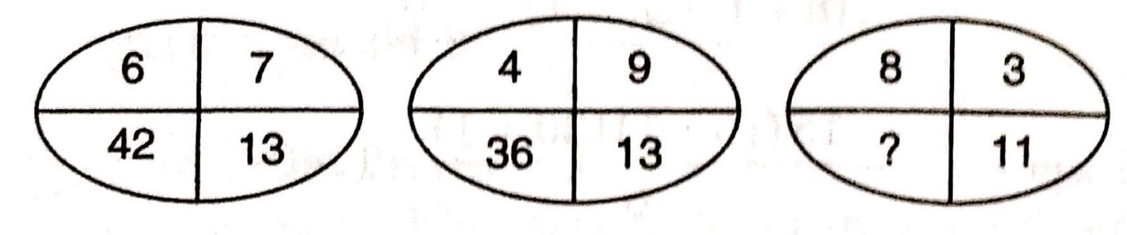
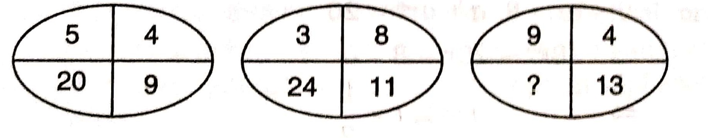
Direction (Q. No. 25 & 26)
In these questions, choose the appropriate number for the quadrant in which question mark appears
25.
a) 30 b) 24 c) 18 d) 12
26.
a) 36 b) 117 c) 52 d) 26

Slide 13
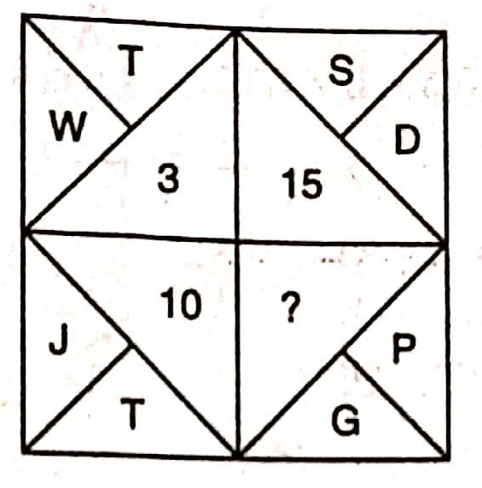
Direction (Q. No. 27 & 28)
Find out the missing letter/number in place of ?
27.
a) 11 b) 5 c) 9 d) 13

Slide 14
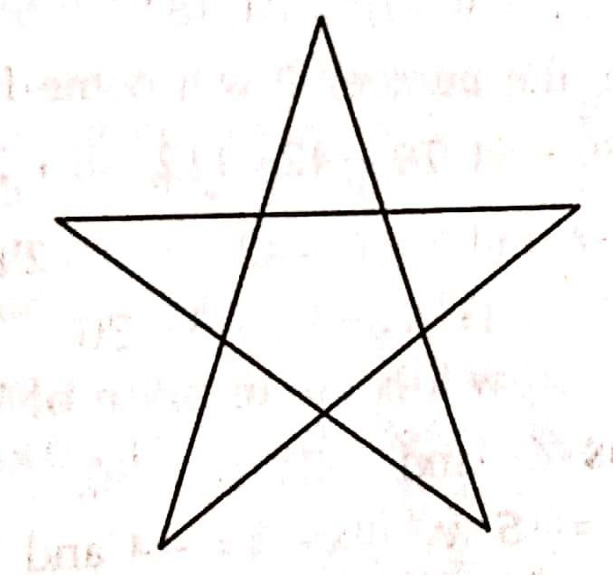
27. How many triangles re there in the following diagram of a 5 cornered star
a) 6 b) 10 c) 12 d) 14

Slide 15
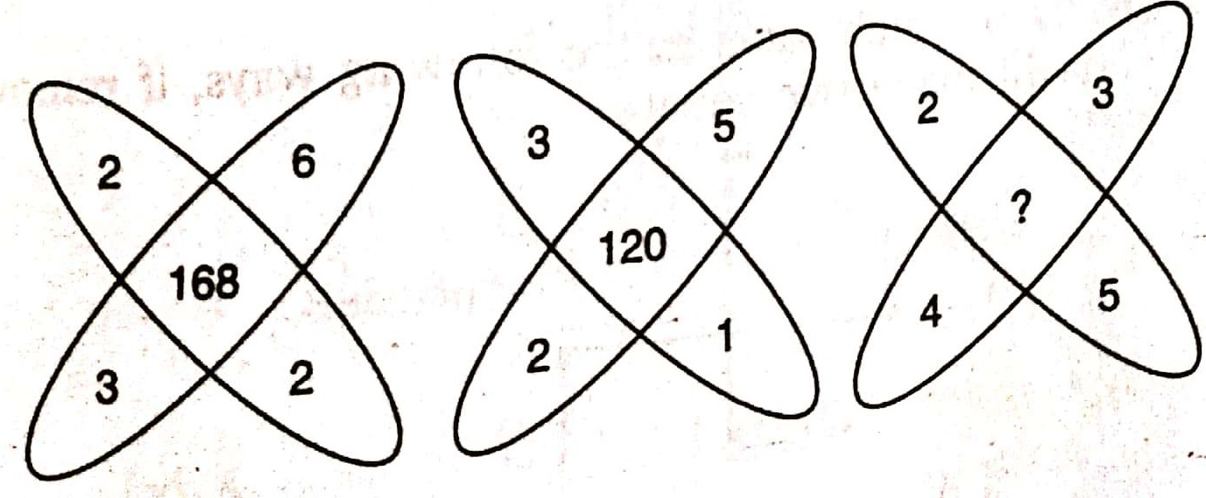
28. In this question find missing number
a) 240 b) 195 c) 84 d) None of the above

