Slide 1



Slide 2
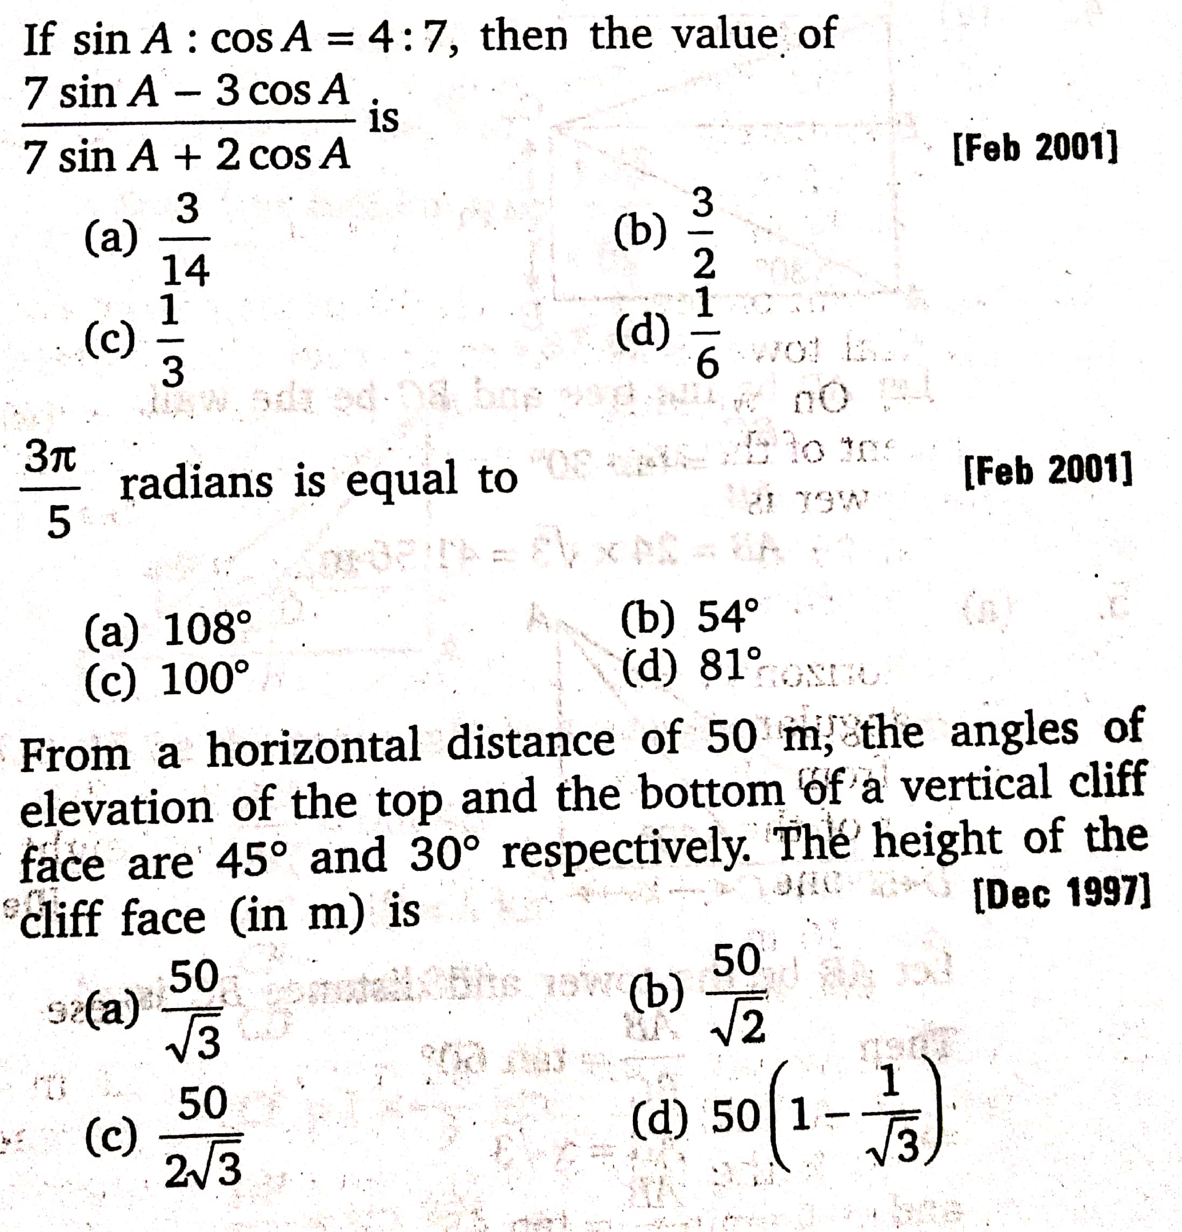
1.
2.
3.

Slide 3
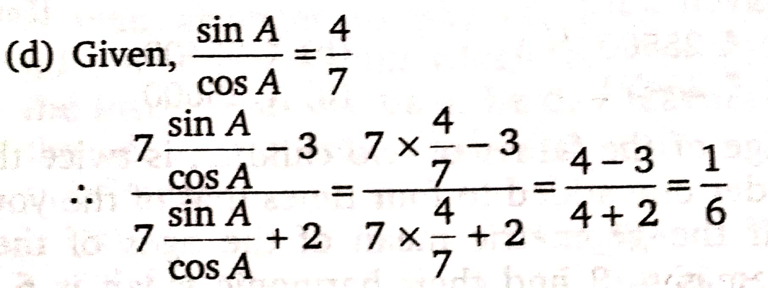
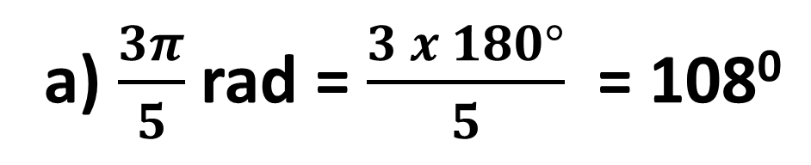
Ans. 1.
Ans. 2.
a) $\frac{3π}{5}$ rad = $\frac{3 x 180°}{5}$ = 108⁰

Slide 4
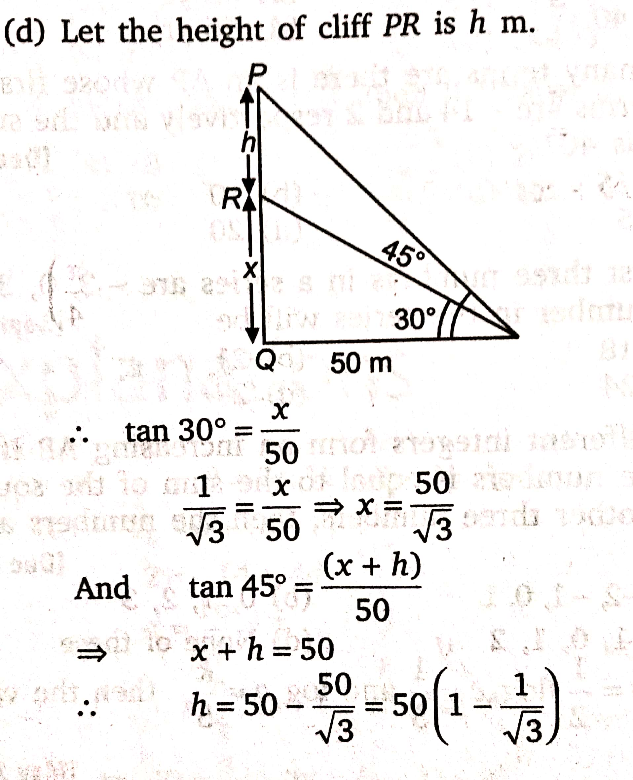
Ans. 3.

Slide 5
4. Find the 1st term of the AP whose 7th and 11th terms are respectively 37 and 57.
5. A number 21 is divided into three parts which are in AP and sum of their squares is 155. Find the largest number.
6. How many natural numbers between 200 to 500 are multiples of 3?
7. The 8th term of a GP is 16 times the 4th term. What will be the first term when its sixth term is 64.
8. A and B are two numbers whose AM is 61 and GM is 11. What will be the possible value of A?

Slide 6
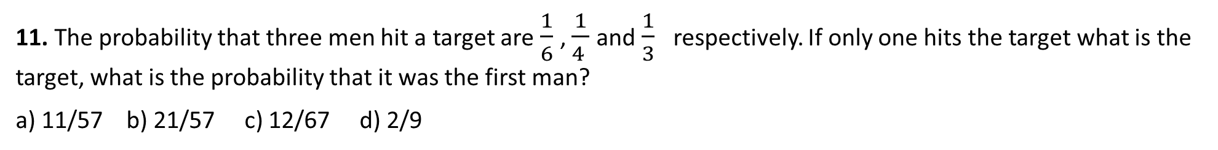
9. Find the number of terms in the series 1/8, 1/2, 2…….8192.
10. A rubber ball rebounds (5/6)th of its height after striking to the ground form which it has fallen. Find the total distance that it travels before coming to rest, if it is gently dropped from a height of 360 metres.
11. The probability that three men hit a target are $\frac{1}{6}$, $\frac{1}{4 }$and $\frac{1}{3}$ respectively. If only one hits the target what is the target, what is the probability that it was the first man?
a) 11/57 b) 21/57 c) 12/67 d) 2/9
12. A bag contains 100 tickets numbered 1, 2, 3,........,100 If a ticket is drawn out of it at random, what is the probability that the ticket drawn has the digit 2 appearing on it
a) 21/100 b) 19/100 c) 32/100 d) 23/100

Slide 7
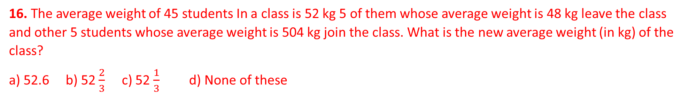
13. The batting average of 40 innings of a cricket player is 50 runs. His highest scorer exceeds his lowest score by 172 runs. If these two innings are excluded at the average of the remaining 38 innings is 48. His highest score was?
a) 172 b) 173 c) 174 d) 176
14. Nine persons went to a hotel for taking their meals 8 of them spent ₹ 12 each over their meals and the 9th spent ₹ 8 more than the average spending of all the nine. Total money spent by them was?
a) ₹ 104 b) ₹ 105 c) ₹ 116 d) ₹ 117
15. The batsman makes a score of 98 runs in the 19th innings and thus increases his average by 4. What is his average after 19th innings?
a) 22 b) 24 c) 28 d) 26
16. The average weight of 45 students In a class is 52 kg 5 of them whose average weight is 48 kg leave the class and other 5 students whose average weight is 504 kg join the class. What is the new average weight (in kg) of the class?
a) 52.6 b) 52 $\frac{2}{3}$ c) 52 $\frac{1}{3}$ d) None of these

Slide 8
From 17 – 20 PNC Questions

Slide 9
21. A father's age is three times the sum of the ages of his two children, but 20 year hence his age will be equal to the sum of their ages. Then, the father's age is
a) 30 year b) 40 year c) 35 year d) 45 year
22. If 6 year are subtracted from the present age of Randheer and the remainder is divided by 18, the present age of his grandson Anup is obtained. If Anup is 2 yer younger to Mahesh, whose age is 5 years then what is the age of Randhir?
a) 84 year b) 96 year c) 48 year d) 60 year
23. In a family each daughter has the same number of brothers as she has sisters and each son has twice as many sisters as he has brothers. How many Suns are there in the family?
a) 4 b) 3 c) 2 d) 5
24. Anil is at present one-fourth the age of his father. After 16 year, he will be one-half age of his father Find the present age of Anil's father?
a) 40 years b) 36 years c) 32 years d) 28 years

