Slide 1

Capgemini Training Program

Slide 2
Capgemini Block Puzzles

Slide 3
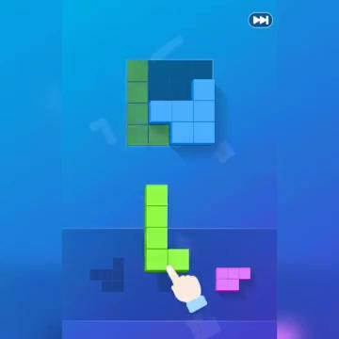
Puzzle - 1

Slide 4

Puzzle - 2

Slide 5

Puzzle - 3

Slide 6

Puzzle - 4

Slide 7
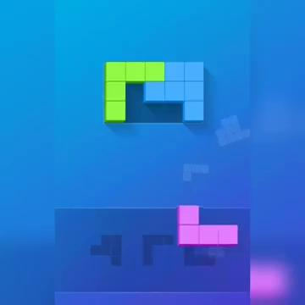
Puzzle - 5

Slide 8

Puzzle - 6

Slide 9
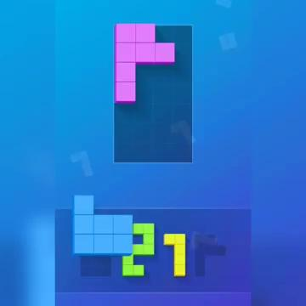
Puzzle - 7

