Slide 1


Slide 2
Grid Challenge
Remember the position of shaded dots, in the sequence that they appear.
You need to remember the highlighted grid position
Simultaneously, mark if the next two shown figures are symmetrical or not
At the end you need to mark all the highlighted grid in last slide

Slide 3
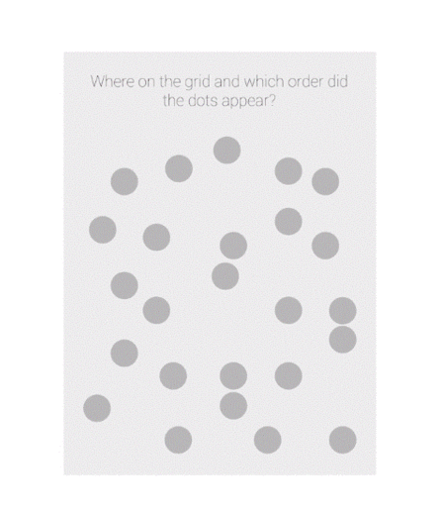

Slide 4
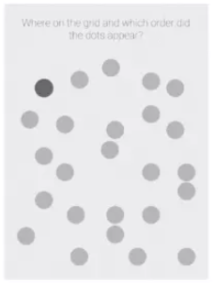
Remember the position of dot

Slide 5
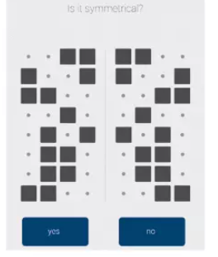
Mark “yes”, if they are symmetrical, otherwise “no”

Slide 6
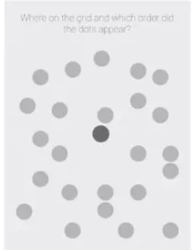
Remember the position of dot

Slide 7
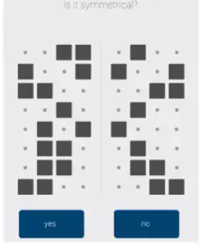
Mark “yes”, if they are symmetrical, otherwise “no”

Slide 8
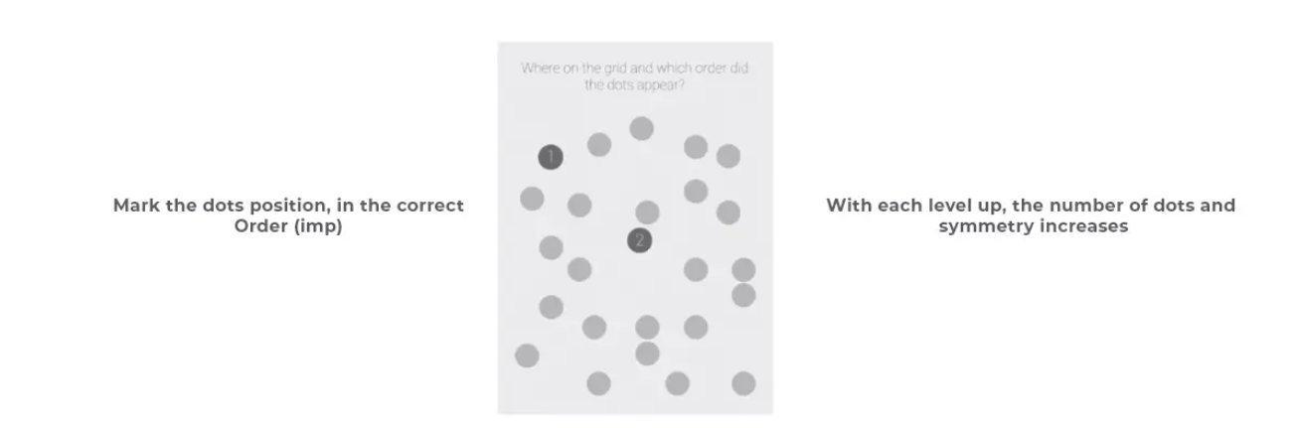

Slide 9
Level - 1

Slide 10

1.

Slide 11

1.Remember the position of dot

Slide 12

Is this Symmetrical?

Slide 13

Is this Symmetrical?

Slide 14
1.Remember the position of dot

Slide 15
Is this Symmetrical?

Slide 16

Is this Symmetrical?

Slide 17
1.

Slide 18
1.
1

Slide 19
1.Mark the positions of dots with proper sequence(imp)
2
1

Slide 20
Level - 2

Slide 21
2.Remember the position of dot

Slide 22
2.Remember the position of dot

Slide 23
Is this Symmetrical?

Slide 24
Is this Symmetrical?

Slide 25
2.Remember the position of dot

Slide 26
Is this Symmetrical?

Slide 27
Is this Symmetrical?

Slide 28
2.Remember the position of dot

Slide 29
Is this Symmetrical?

Slide 30
Is this Symmetrical?

Slide 31
2.Mark the positions of dots with proper sequence (imp)

Slide 32
2.
1
1

Slide 33
2. Mark the position of dots with proper sequence
1
1
2

Slide 34
2.
3
1
1
2

Slide 35
Level - 3

Slide 36
3.Remember the position of dot

Slide 37
3.Remember the position of dot

Slide 38
Is this Symmetrical?

Slide 39
Is this Symmetrical?

Slide 40
3.Remember the position of dot

Slide 41
Is this Symmetrical?

Slide 42
Is this Symmetrical?

Slide 43
3.Remember the position of dot

Slide 44
Is this Symmetrical?

Slide 45
Is this Symmetrical?

Slide 46
3 Remember the position of dot

Slide 47
Is this Symmetrical?

Slide 48
Is this Symmetrical?

Slide 49
3Mark the positions of dots with proper sequence (imp)

Slide 50
3.
1

Slide 51
3.
2
1

Slide 52
3.
3
2
1

Slide 53
3.
4
3
2
1

Slide 54
Level - 4

Slide 55
4.Remember the position of dot

Slide 56
4.Remember the position of dot

Slide 57
Is this Symmetrical?

Slide 58
Is this Symmetrical?

Slide 59
4.Remember the position of dot

Slide 60
Is this Symmetrical?

Slide 61
Is this Symmetrical?

Slide 62
4.Remember the position of dot

Slide 63
Is this Symmetrical?

Slide 64
Is this Symmetrical?

Slide 65
4.Remember the position of dot

Slide 66
Is this Symmetrical?

Slide 67
Is this Symmetrical?

Slide 68
4.Remember the position of dot

Slide 69
Is this Symmetrical?

Slide 70
Is this Symmetrical?

Slide 71
4.Mark the positions of dots with proper sequence (imp)

Slide 72
4.
1

Slide 73
4.
1
2

Slide 74
4.
3
1
2

Slide 75
4.
3
4
1
2

Slide 76
4.
3
4
1
2
5

Slide 77
Level - 5

Slide 78
5.Remember the position of dot

Slide 79
5.Remember the position of dot

Slide 80
Is this Symmetrical?

Slide 81
Is this Symmetrical?

Slide 82
5. Remember the position of dot

Slide 83
Is this Symmetrical?

Slide 84
Is this Symmetrical?

Slide 85
5.Remember the position of dot

Slide 86
Is this Symmetrical?

Slide 87
Is this Symmetrical?

Slide 88
5.Remember the position of dot

Slide 89
Is this Symmetrical?

Slide 90
Is this Symmetrical?

Slide 91
5.Remember the position of dot

Slide 92
Is this Symmetrical?

Slide 93
Is this Symmetrical?

Slide 94
5.Remember the position of dot

Slide 95
Is this Symmetrical?

Slide 96
Is this Symmetrical?

Slide 97
5.Mark the positions of dots with proper sequence (imp)

Slide 98
5.
14

Slide 99
5.
24
14

Slide 100
5.
24
3
14

Slide 101
5.
24
3
4
14

Slide 102
5.
5
24
3
4
14

Slide 103
5.
5
24
3
4
14
6

Slide 104


