Slide 1


Slide 2
Game Based Assessment for Capgemini :-
Gamified Aptitude Test(Capgemini)
          FIND THE NEXT FIGURE OF THE SERIES

Slide 3
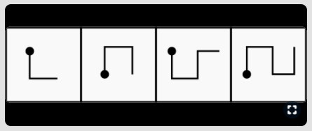
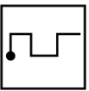

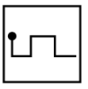
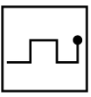
Question 1)
OPTIONS:
A) B) C) D)

Slide 4
Answer :- C
Option C is correct.
Since, The fig. gets reversed in each step and an extra line added to it in a set pattern

Slide 5
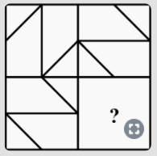
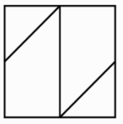
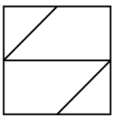
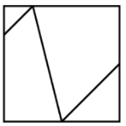
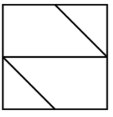
Question 2)
OPTIONS:
A) B) C) D)

Slide 6
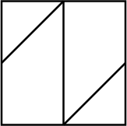
Answer :- A
EXPLAINATION:
After observing we could understand that in each quadrant to get the answer of next quadrant we are rotating by an angle of 90 degree in clockwise direction. Hence, rotate the figure in quadrant 2 by an angle of 90 degree in clockwise direction. Hence, option A is the correct answer.

Slide 7
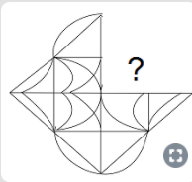




Question 3)
OPTIONS:
a) b) c) d)

Slide 8

ANSWER:- D
Correct option is D
By visualizing the figure it is clear that after placing the image in option D in missing area ,Given figure must be generated,else it can also be solved by drawing the image D in a tracing paper and placing D over the missing AREA.
Hence, option 'D' is correct.

Slide 9
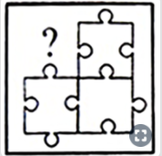




Question 4)
OPTIONS:
a) b) c) d)

Slide 10

ANSWER:- B
Correct option is
B
From the given information we could understand that small curved designs on side wards are once projecting out ward both and in the next thing projecting inside both of them.Here for the required one's we need it to be projecting outward because in the third quadrant those are projecting inside.Hence option B is the correct answer.

Slide 11

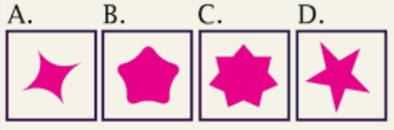
Question 5)

Slide 12

ANSWERE: A
From the given information we could understand that small designs on side wards are HAVING DECREASES NO OF SIDES BY STEPS.

Slide 13


Question 8)
(a) (b) (c) (d) (E)

Slide 14
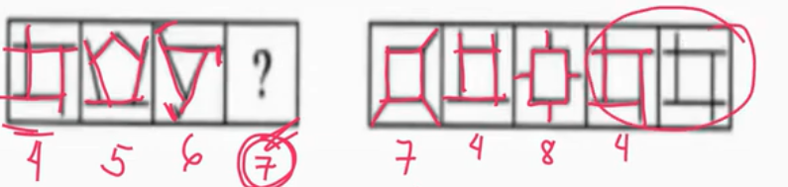
ANSWER: A
EXPLAINATION:
HERE FROM GIVEN INFORMATION THE PATTERN CHANGES WITH INCREASE SIDES ONE BY ONE WITH PATTREN OF EDGES.

Slide 15
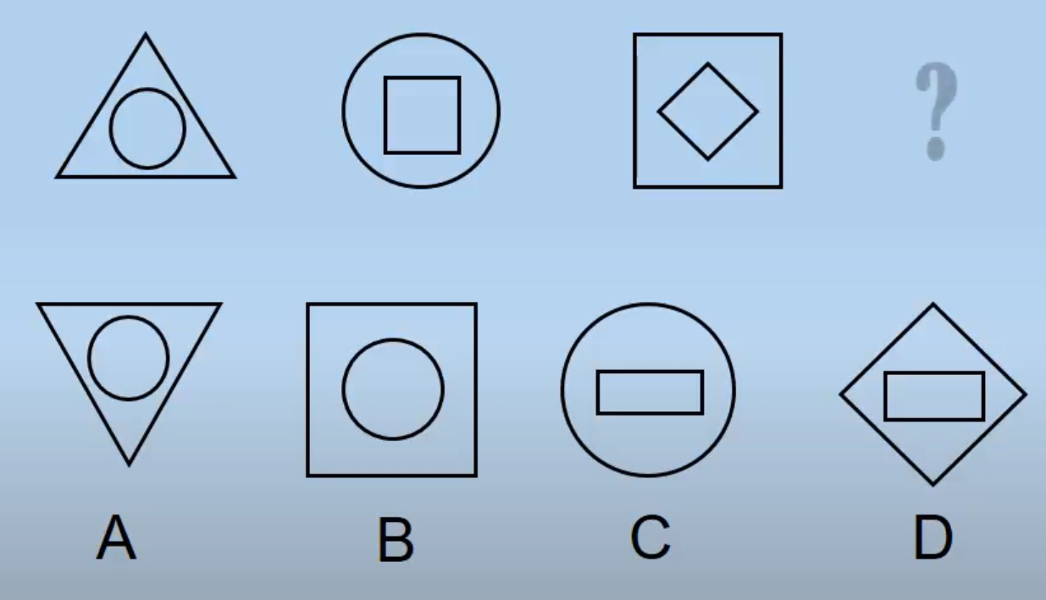
Question 9)

Slide 16
ANSWER: D
EXPLAINATION:
WITH THE INFORMATION GIVEN BY FIGURES THE FIRST FIGURE REVERTS THE INNER AND OUTER FIGURES IN NEXT FIGURE .

Slide 17


Question 10)

Slide 18
ANSWER: A
EXPLAINATION:
FROM GIVEN DATA THE CUBES IN SQUARE ARE INCREASES BY ONE EACH WITH CONTRAST BLACK AND WHITE CUBES. THAT FIRST SQUARE CONTAI 3 SMALL CUBES , 2ND HAVE 4, 3RD HAVE 5, 4TH HAVE SIX AND NEXT 5TH SHOULD BE 6 SMALL CUBES.

Slide 19


Question 11)

Slide 20
ANSWER: C
EXPLAINATION: HERE THE FIGURES CONTAIN 2 CIRCLES WHICH SMALLER CIRCLE HAVING INCREASING LINES BY ONE WITH BLACK AND WHITE INNLET CIRCLES WITH ODD PLACES.

Slide 21


Question 12)

Slide 22
ANSWER: C
EXPLAINATION:

Slide 23
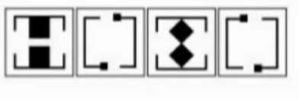
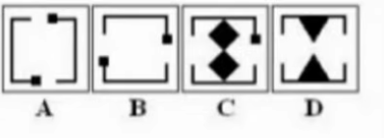
Question 13)

Slide 24
ANSWER: D
EXPLAINATION:

Slide 25
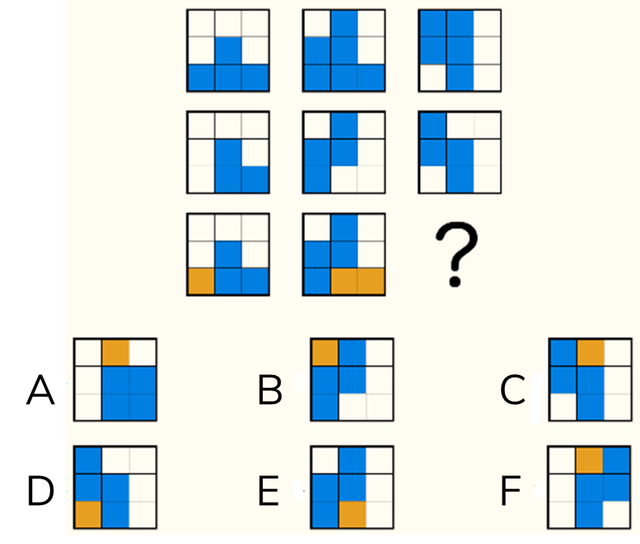
Question 14)

Slide 26
Answer: C
Explanation:
Considering column wise,
Figure 1 + Figure 2 = Figure 3
The non-overlapping parts between figures 1 and 2 are shaded in yellow. The overlapping parts are shaded in blue.

Slide 27
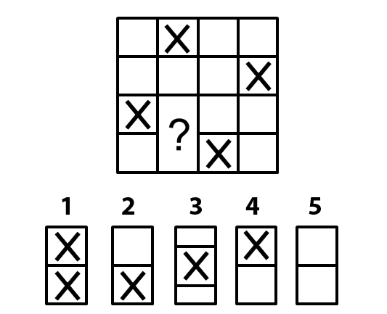
Question 15)

Slide 28

Answer:
Explanation:
Each row and column should have exactly one cross mark. As the pattern already exists on the question figure, the missing part should not contain any cross marks.

