Slide 1

Number Series

Slide 2

Type 1: Square Series
1] 15 19 35 71 135 ?
Ans : 235
135+100=235
Type 2: Cube Series
2] 403 746 962 1087 1151 ?
Ans : 1178
Type 3: Factorial
3] 512 392 368 362 360 ?
1! 1, 2! 2, 3! 6, 4! 24, 5! 120, 6! 720, 7! 5640
Ans : 361

Slide 3
4] 38 57 74 87 98 105 ?
➔ Prime Nos. upto 50 [2, 3, 5, 7, 11, 13, 17, 19, 23, 29, 31, 37, 41, 43, 47]
Ans. 110
5] 75 108 148 202 277 ?
➔ 75 108 148 202 277
33 40 54 75 103
+7 +14 +21 +28
Ans. 380

Slide 4
6] 1 9 21 28 81 65 261
➔
2³+1 3³+1 4³+1
1 9 21 28 81 65 261
Ans. 121
7] 12 40 61 55 367 72 2570 ?
➔
7²-9 8²-9 9² -9
12 40 61 55 367 72 2570
x5+1 x6+1 x7+1
Ans. 91

Slide 5
8] x² = 1 2 3 4 5 4 3 2 1 Find ‘x’.
➔
11²= 121, 111²= 12321 1111²= 1234321
Ans. X=111111.

Slide 6
9] Find the Square of 206, 304, 404, 506, 609
➔
206² = 42436
304² = 92416
404² = 163216
506² = 256036
609² = 370881
For 200
4 4d d²
For 300
9 6d d²
For 400
16 8d d²
For 500
25 10d d²
For 900
81 18d d²

Slide 7
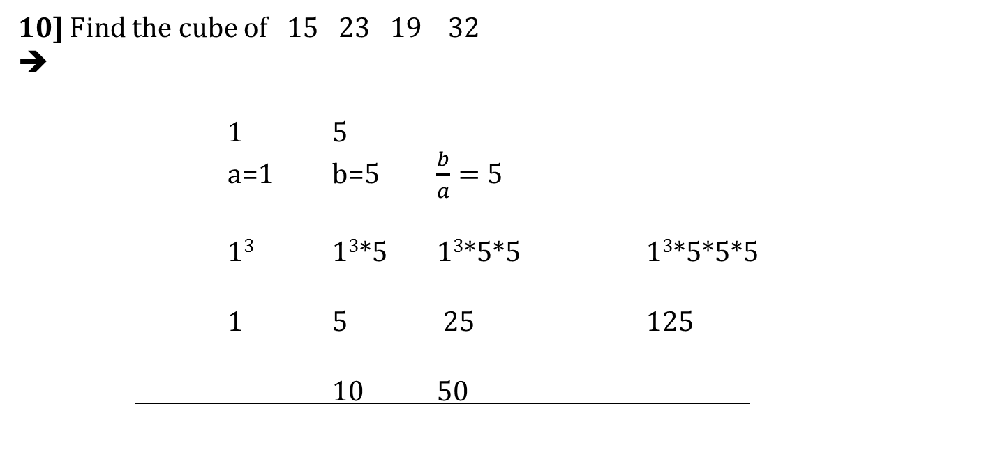
10] Find the cube of 15 23 19 32
➔
1 5
a=1 b=5 $\frac{b}{a}=$5
1³ 1³*5 1³*5*5 1³*5*5*5
1 5 25 125
10 50
3
[2] 3
[8] 7
[12] 5

Slide 8
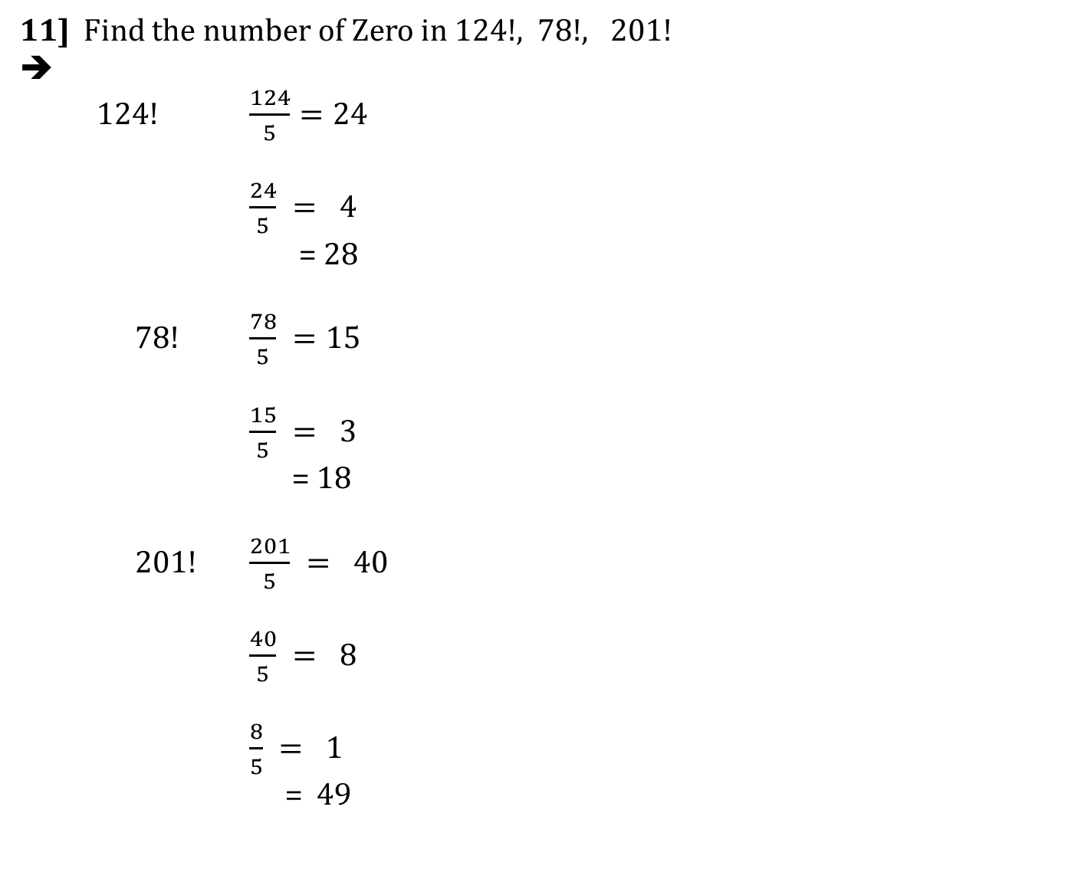
11] Find the number of Zero in 124!, 78!, 201!
➔
124! $\frac{124}{5}=24$
$\frac{24}{5} = 4$
= 28
78! $\frac{78}{5} =15$
$\frac{15}{5} = 3$
= 18
201! $\frac{201}{5} = 40$
$\frac{40}{5} = 8$
$\frac{8}{5} = 1$
= 49

