Slide 1
APT-TECH
Blood Relations,
Direction,
Truth Verification,

Slide 2
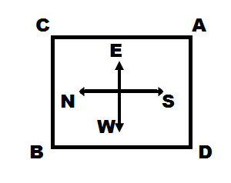
Q1) During my last visit to Paris, I was walking straight towards the Eiffel Tower. I walked for 3 km then took a 900 turn so that the tower was now on my left side. I kept on walking for 2 km in this direction, before taking another 900 turn, so that it was on my right side. After walking for 3 km in this direction, I took right turn and walked 1 km. the point where I stopped was on which side of the point, I stated from?
1) Left 2) Right 3) Behind 4) Ahead
Direction for questions 2 to 6: Following questions are based on the diagram given below showing four persons stationed at the four corners of a square piece of plot as shown:
Notes:
Repeated AR 1 task 5&

Slide 3
Q2) A starts crossing the field diagonally. After walking half the distance, he turns right , walks some distance and turn left. Which direction A is facing?
A] North-East B] North-West C] North D] South-East
Q3) From the original position given in the above figure, A and B move one arm length clockwise and then cross over to the corner diagonally opposite; C and D move one arm length anti-clockwise and then cross over to the corner diagonally opposite. The original configuration ABCD has now changed to ..
A] CBDA B] BDAC C] ACBD D] BCAD
Q4) From the original position, B and D move one and half length clockwise and anti-clockwise respectively. Which one of the following statement is true?
A] B and D are both at the midpoint between A and C
B] D is at the midpoint between A and C and B at the corner originally occupied by C.
C] B is at the midpoint between A and C and D at the corner originally occupied by A.
D] B and D are both at the midpoint between A and D
Q5) After the movement given in Q.4 above, who is t the North-East corner?
A] A B] B C] C D] Indeterminable
Notes:
Repeated AR 1 task 5&

Slide 4
Direction for Q6 to Q9: Following are the positions of different cities with respect to each other.
- Catelona is to the south of Frisbee, but to the west of Derby.
- Frisbee is to the south of Ewing which is the east of Derby.
- Abulaki is the south of Burdan which is the west of Frisbee.
- Ewing is the south of Abulaki which is the west of Catelona.
- Derby is the south of Frissbee which is the west of Abulaki.
Q.6) Which of the following statement cannot be derived from the given information?
1) Burdan is the west of Abulaki 2) Derby is to the south of Abulaki
3) Abulaki is to the west of Ewing 4) Catelona is to the south of Derby
Q.7 Which of the following is / are north east of Frisbee?
i) Abulaki ii) Ewing iii) Catelona
1) i only 2) ii only 3) i and iii 4) i and ii
Q.8 Which of the following are situated to the south west of at least one other city?
1) Abulaki, Frisbeeand Derby 2) Catelona, Derby and Frisbee
3) Abulaki, CAtelona and Frisbee 4) CAtelona, Derby and Ewing
Q.9 Which of the following statements would make the information given in numbered statements more specific?
1) Catelona is to the north of Derby 2) Ewing is to the north of Derby
3) Abulaki is to the east of Burdan 4) Catelona is to the east of Frisbee
Notes:
Repeated AR 1 task 5&

Slide 5
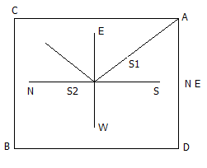
Solutions:-
ET
2km
3km 3km
1km
E
2)

Slide 6
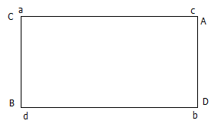
3)
6-9)
B x B
B F A C D E
E E x
F x F
D D x
C C x

Slide 7
Directions for Q 10 to 12: Answer the question based on the following data.
A is the father of the C. But C is not his son.
E is the daughter of C. F is the spouse of A.
B is the brother of C. D is the son of B.
G s son of B. H is the father of G.
Q10) Who is the grand mother of D?
A] A B] C C] F D] H E] Indeterminable
Q11) Who is the son of F?
A] B B]C C] D D] E E] Indeterminable
Q12) C is A’s father’s nephew. D is A’s cousin but not the brother of C. How is D related to C?
A] Father B] Sister C] Mother D] Aunt
E] indeterminable
Notes:
Repeated AR 1 task 5&

Slide 8
Directions for Q 13 to 17: Answer the question based on the following data.
A family consists of the six members P, Q, R, X,Y and Z . Q is the son of R but R is not mother of Q. P and R are the married couple. Y is the brother of R. X is the daughter of P. Z is the brother of P.
Q13) Who is the brother-in-law of R?
A] P B] Z C] Y D] X E] Indeterminable
Q14) Who is the father of Q?
A] R B] P C] Z D] None of these
Q15) How many children does P have?
A] 1 B] 2 C] 3 D] 4 E] indeterminable
Q16) How many female members are there in the family?
A] 1 B] 2 C] 3 D] 4 E] indetermenable
Q17) How is Q related to X
A] Husband B] Father C] Brother D] Uncle E] indeterminable
Notes:
Repeated AR 1 task 5&

Slide 9
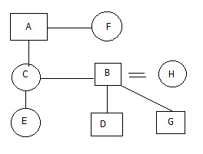

10–11)
12)
Notes:
Repeated AR 1 task 5&

Slide 10
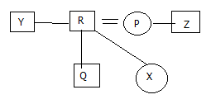
13-17)
Notes:
Repeated AR 1 task 5&

Slide 11
APT-TECH
Truth Verification, Cube

Slide 12
Directions for Q 18 to Q.22: Answer the question based on the following data.
Four mountain climbers, Hillary, Norgay, Hunt and Austen each saw a sight while climbing Mt. Everest - - a bird, a plane, Superman and a ship. However, none saw what any of the others saw. In order to alleviate the tedium back at base camp they decide to quiz the other members of the camp. Each makes two false statements and one true statement. Read their statements and answer the question that follows:
Hillary : I saw superman. Norgay saw the ship. Hunt did not see the plane.
Hunt : Hillary saw superman. Norgay did not see superman . I saw the plane.
Norgay: Hunt saw the plane . I did not see the ship. Austen didn’t see the bird
Austen: I saw a ship. Norgay saw the plane. Hillary saw the bird.
Notes:
Repeated AR 1 task 5&

Slide 13
18) Hillary Saw…..
(1) a bird (2) a plane (3) a ship (4) superman
19) Norgay saw…..
(1) a bird (2) a plane (3) a ship (4) superman
20) Hunt saw…..
(1) a bird (2) a plane (3) a ship (4) superman
21) Austen saw….
(1) a bird (2) a plane (3) a ship (4) superman
22) Which of the following is false?
(1) Hunt’s saw second statement is true.
(2) Hillary’s second statement is true.
(3) Norgay’s second statement is true.
(4) Austen’s second is true.
Notes:
Repeated AR 1 task 5&

Slide 14
Directions for Q 23 to 25: Answer the question based on the following data.
Ajit : Michael killed him. Peter was his accomplice.
Robert : Ajit killed him. Michael was his accomplice.
Peter : Robert neither killed him nor helped in killing him. I neither killed him nor helped in killing
Michael : Robert is lying. I was with peter all through the time in question.
Who killed Rox?
(1) Ajit (2) Robert (3) Peter (4) Michael
Who was the accomplice?
(1) Ajit (2) Robert (3) Peter (4) Michael
Notes:
Repeated AR 1 task 5&

Slide 15
Directions for Q 23 to 25: Answer the question based on the following data.
There is a cube in which one pair of opposite faces is painted red, the second pair of opposite faces painted blue and the third pair of opposite faces is painted green. This cube is now cut into 216 smaller but identical cubes.
How many small cubes are there with no red paint at all ? A]121 B]144 C]169 D]100
How many small cubes are there with at least two different colors on their faces? A]49 B]64 C] 56 D]81
How many small cubes are there without any face painted? A]49 B]64 C] 36 D]81
How many small cubes are there with only red and green on their faces? A]9 B]12 C]27 D]16
How many small cubes are there showing only green or only blue on their faces? A] 64 B] 81 C]125 D] 100
Notes:
Repeated AR 1 task 5&

