Slide 1


Slide 2
Game Based Cognitive Assessment for
Cap-Gemini.

Slide 3
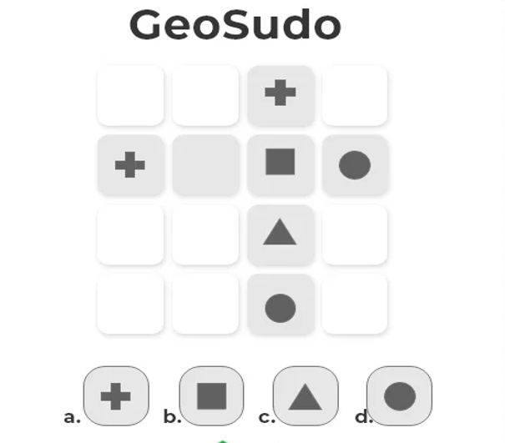
1.
Explanation:
Its a simple symbol sudoku game, since in the vertical lines there are four different shapes, and in the horizontal line only one of that symbol is missing, and the rule of sudoku says, that in any line there can be no two same symbols, hence option c will be the correct answer.
Option C.

Slide 4
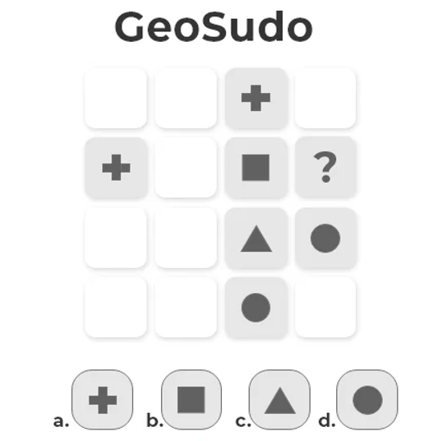
2.
Explanation:
We have two symbols missing in the horizontal line, now if you in the last column, we have a circle, so it means that at ? there cannot be a circle, so now we can place a circle next to plus symbol in row 2, that leaves us only with the triangle symbol that is missing hence option c is the correct option
Option C.

Slide 5
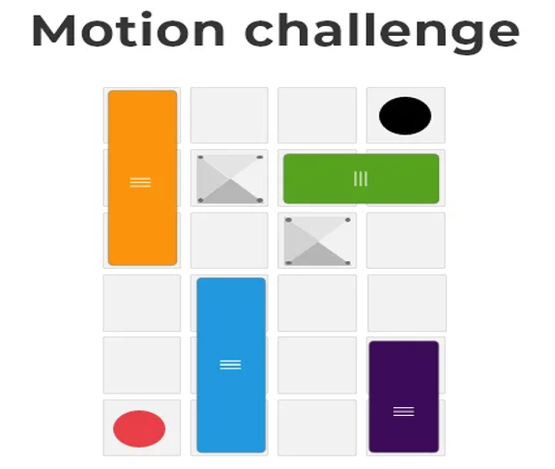
3.
In how many minimum numbers of steps you can move the red ball to the hole.
Options:
a. 7 steps b. 5 steps
c. 8 steps d. 3 steps

Slide 6
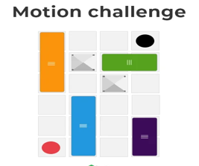
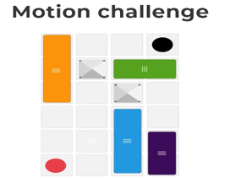
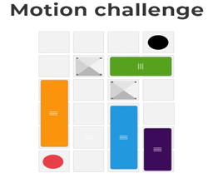
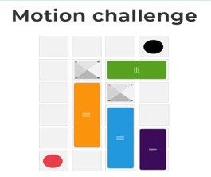
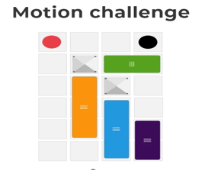
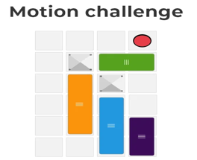
Explanation:
Step - 1
Step - 2
Step - 3
Step - 4
Step - 5

Slide 7
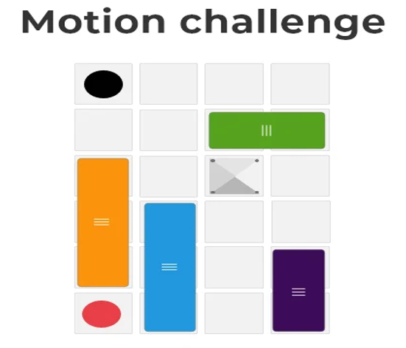
4.
In how many minimum numbers of steps you can move the red ball to the hole.
Options:
a. 3 steps b. 4 steps
c. 6 steps d. 8 steps
Explanation:
Step 1: We have blue block first we need to move it on right hand side.
Step 2: Then we need to move the orange block to the right hand side.
Step 3: Lastly the column between hole and red ball will be empty, that means we can directly move the ball to the hole.
That’s how we can move the red ball to the black hole in 3 steps, hence option a is the correct option
Option A.

Slide 8
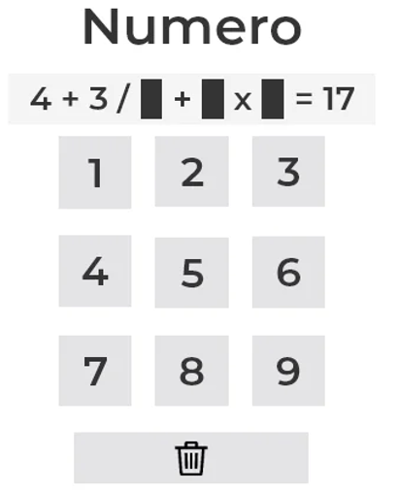
5.
Solve the following equation.
Options:
a. 3, 5, 2 b. 3, 4, 1
c. 3, 6, 2 d. 2, 5, 3
Explanation:
Here's the complete equation
4 + (3/3) + 6 * 2 = 17

Slide 9
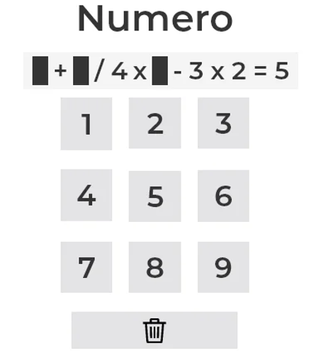
6.
Solve the following equation.
Options:
a. 4, 8, 1 b. 3, 8, 2
c. 2, 4, 8 d. 3, 8, 4
Explanation:
Here's the complete equation
3 + (8/4) * 4 - 3 * 2 = 5

Slide 10
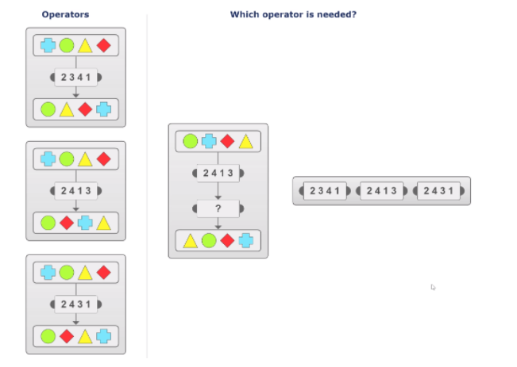
7.
Which operator is needed?
Explanation:
From the given row,
Position 1 is occupied by a circle
Position 2 is occupied by a plus sign
Position 3 is occupied by a rhombus
Position 4 is occupied by a triangle
After 2413,
Position 1 is occupied by a Plus sign
Position 2 is occupied by a Triangle
Position 3 is occupied by a Circle
Position 4 is occupied by a Rhombus
In the final row, the order is a triangle, circle, rhombus, plus sign which can be translated as 2341.
Answer: 2341

Slide 11
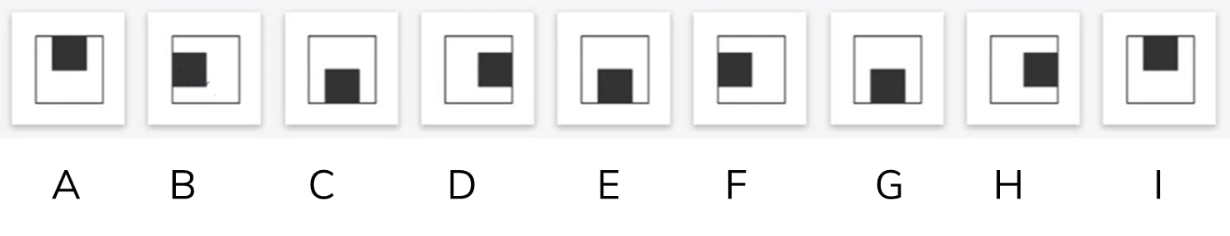
8.
Pick the one that doesn’t fit the group.
Explanation:
In each step, the shaded square moves 1 position in an anticlockwise direction along the sides of the outer square. In figure E, the shaded square should be along the top edge of the outer square. But it was given along the bottom edge of the outer square and hence the odd man.
Answer: E

Slide 12
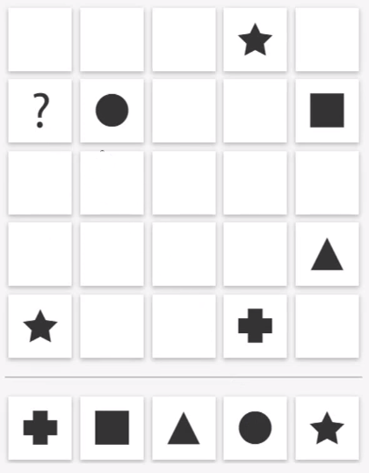

9.
Find the missing part.
Explanation:
Each row/ column should have all five shapes (triangle, plus sign, square, circle, star).
If we consider row 2, a star can be fixed only at grid 23. So, a plus sign can be fixed at the first column of the second row. So, the question should be replaced by a plus sign.
Answer:

Slide 13
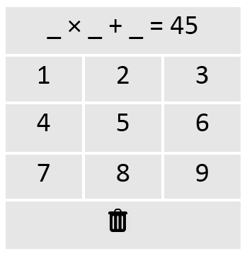
10.
Enter the unique digits that satisfy the given equation.
Answer: 6 × 7 + 3 = 45

Slide 14
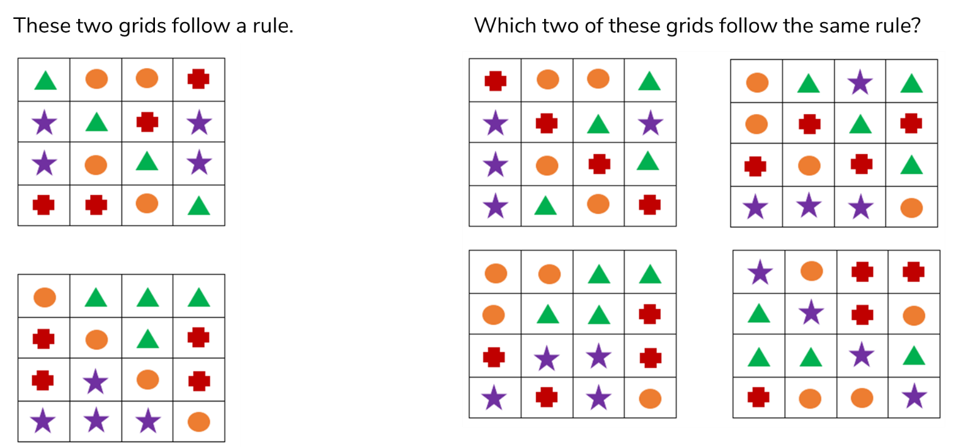
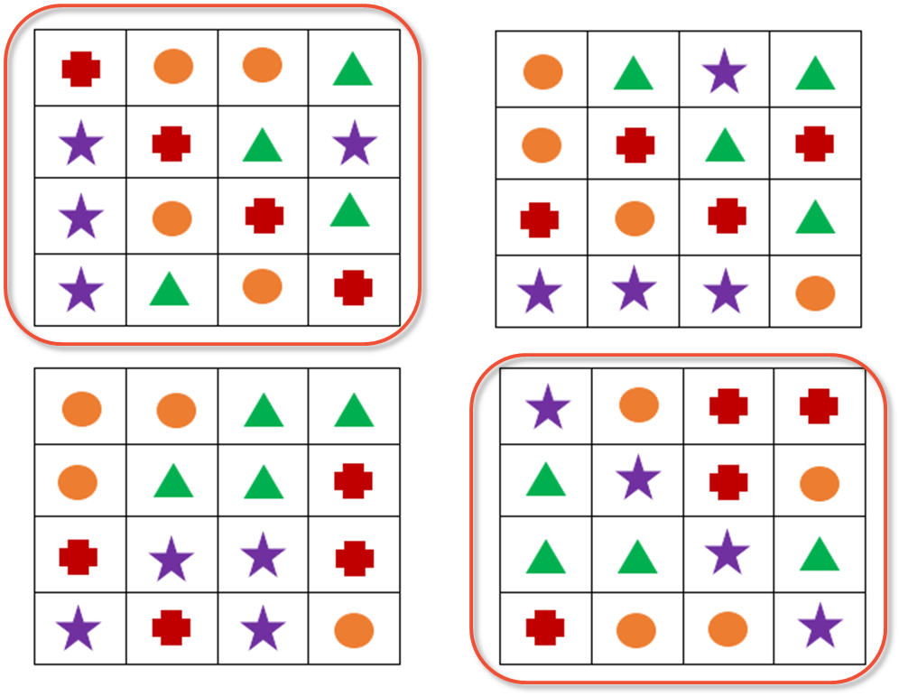
11.
Answer:
Explanation:
Elements along the diagonal are similar.

Slide 15
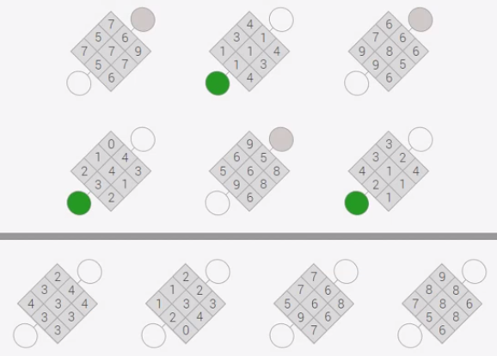
12.
Identify the pattern in which the question grids are coloured and following the same pattern colour the given grids.

Slide 16
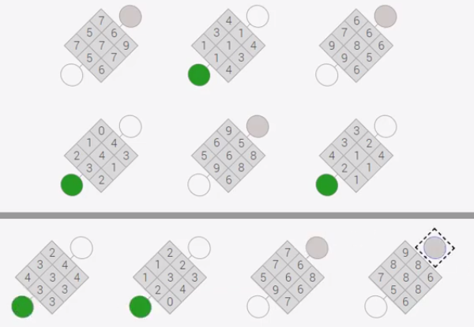
Answer:
Explanation:
Grids with elements in the range of 0 to 4 are colored green. Grids with elements in the range of 5 to 9 are colored grey.

Slide 17
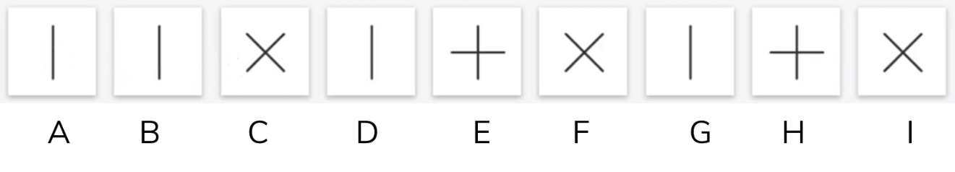
13.
Pick the odd one.
Answer: B
Explanation:
A vertical line, a plus sign and a cross mark repeat in a cycle.

Slide 18
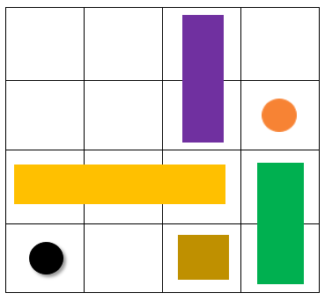
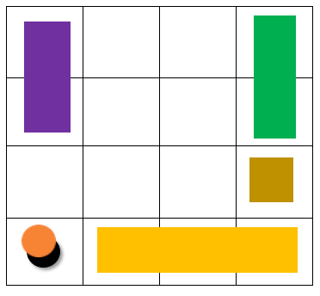
14.
Move the red ball to the hole (marked black) in the given grid.
Answer & Explanation:
The required moves are:
i) Purple block and the ball – 2 positions leftward
ii) Green block – 2 positions upward
ii) Brown block – 1 position rightward and 1 position upward
iii) Yellow block – 1 position downward and 1 position rightward
After these movements, the grid changes as:
Now, the red ball can be taken to the destination without obstacles.

Slide 19
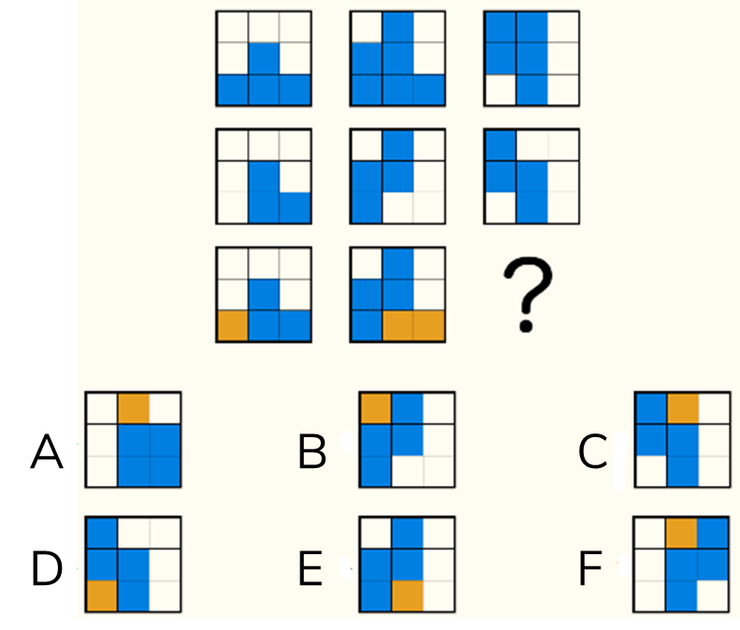
15.
Find the missing part.
Answer: C
Explanation:
Considering column wise,
Figure 1 + Figure 2 = Figure 3
The non-overlapping parts between figures 1 and 2 are shaded in yellow. The overlapping parts are shaded in blue.

Slide 20
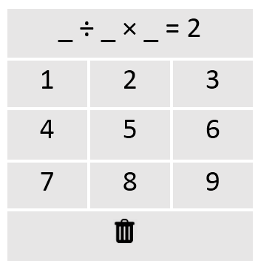
16.
Enter the unique digits that satisfy the given equation.
Answer:
3 ÷ 6 × 4 = 2
1 ÷ 3 × 6 = 2
1 ÷ 4 × 8 = 2
3 ÷ 9 × 6 = 2

Slide 21
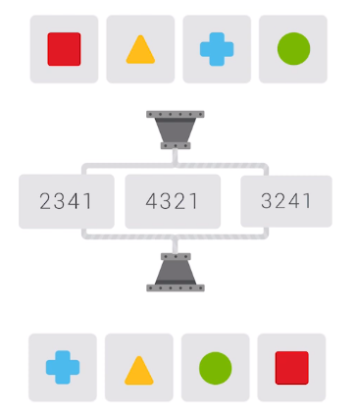
17.
Identify the order of rearrangement.
Answer: 3241
Explanation:
From the given row,
Position 1 is occupied by a square
Position 2 is occupied by a triangle
Position 3 is occupied by a plus sign
Position 4 is occupied by a circle
In the final row, the order is a plus sign, triangle, circle, a square which can be translated as 3241.

Slide 22


18.
Pick the one that doesn’t fit the group.
Answer: (Vth figure)
Explanation:
In the given series of IX figures (say I to IX), each figure contains 5 horizontal lines (say 1 to 5). Exactly one of the lines is broken in the order of 1, 2, 3, 4, 5, 4, 3,2, 1 from figures I to IX respectively. But this order is missed in the Vth figure. Hence is the odd man.

Slide 23


19.
Pick the one that doesn’t fit the group.
Answer: IIIrd figure.
Explanation:
In each of the given IX figures, there are two shapes, out of which, one is shaded and the other is unshaded. But only in the third figure, the two shapes overlap each other. Hence is the odd man.

Slide 24
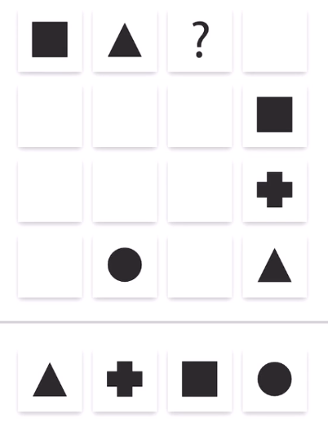
20.
Find the missing part.
Explanation:
Each row/ column should have all four shapes (triangle, plus sign, square, circle).
If we consider column 4, grid 14 should be occupied by a circle. So, grid 13 will be occupied by a plus sign.
Answer:

