Slide 1


Slide 2
CapGemini Marathon
100 Q

Slide 3
SWITCH CHALLENGE
25 Q
Sequence of Geometrical Shapes, go through a switch containing code. This code changes the order of shapes, you’re supposed find the correct code as per input-output

Slide 4
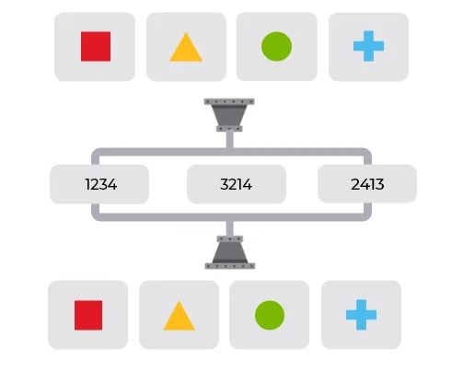
1.
A
>
<
Z
4123
4132
4321

Z
A
<
>

Slide 5
2.
+
-
*
/
1432
1324
1423

A
/
<
*
>
Z
-
+

Slide 6
3.
A
<
>
(
)
2341
2413
2314

A
)
<
<
>
Z
(
>

Slide 7
4.
#
B
$
@
2432
2134
2143

A
#
<
Z
@
>
B
$

Slide 8
5.
U
V
W
X
4123
4213
4321

A
V
<
U
>
Z
W
X

Slide 9
NEXT LEVEL

Slide 10
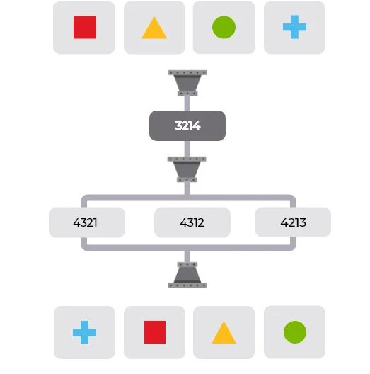
6.
<
>
A
Z
3124
1342
1423
1432

A
Z
<
>

Slide 11
7.
B
Z
=
^
2314
2143
2314
2413

=
Z
^
B

Slide 12
8.
3
4
2
1
1234
3412

3241
3124
2
4
1
3

Slide 13
9.
M
L
O
N
4123
4213
4123
4321

O
L
M
N

Slide 14
10.
4
@
2
$
2341
3412

3124
3214
$
@
2
4

Slide 15
NEXT LEVEL

Slide 16
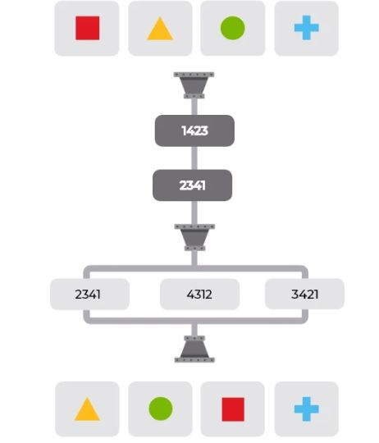
A
B
C
D
11.
1324
2134
2413

2314
2431
A
B
C
D

Slide 17
E
F
G
H
12.
4231
3214
4213
3421
2341

E
F
G
H

Slide 18
I
J
K
L
13.
3214
3214
4321

3214
2341
K
J
I
L
2341

Slide 19
M
N
O
P
14.
3142
3142
2341
4231
4312

M
N
P
O

Slide 20
Q
R
S
T
15.
4123
2143

2314
2431
3421
T
S
Q
R
3421

Slide 21
TYPE CHANGE

Slide 22
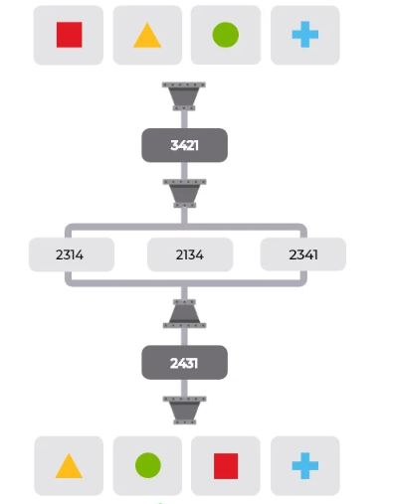
A
U
A
V
A
W
A
X
16.
3142
3421
2143
2341

2314
W
U
V
X

Slide 23
A
A
A
B
A
C
A
D
17.
4123
3142
2431
2143

2314
D
C
A
B

Slide 24
A
/
+
A
-
A
*
A
18.
3142
2143
2431
3142

2314
*
+
-
/
2314

Slide 25
A
]
(
A
)
A
[
A
19.
2413
3421
2134
2431

4123
4132
[
]
(
)
4132

Slide 26
A
B
A
A
%
A
*
A
20.
4123
2134
2431
3214

1342
A
%
*
B

Slide 27
TYPE CHANGE

Slide 28
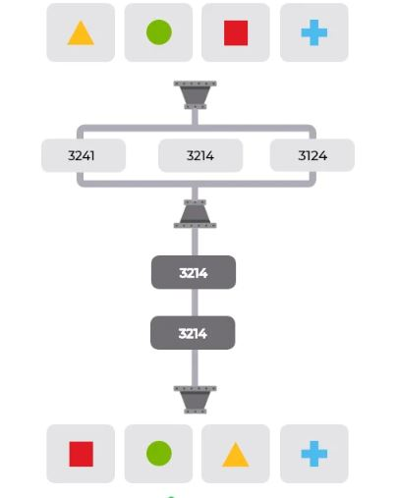
{
<
>
}
A
A
A
21.
3241
2341
4123

4123
4123
>
<
{
}

Slide 29
@
^
%
#
A
A
^
A
#
@
%
A
*
22.
*
23415
15324
32415

35241
23451
#
*
^
@
%

Slide 30
A
B
P
A
A
A
Q
A
23.
1234
2341
3412

1243
1243
Q
B
P
A

Slide 31
A
X
A
W
A
Z
A
Y
24.
4321
3421
3214

3214
2143
Z
W
X
Y

Slide 32
A
C
A
D
A
E
A
F
G
25.
24315
31524
35124

34215
15432
E
G
D
F
C
15432

Slide 33
NUM BUBBLES
10 Q

Slide 34

26.
A > B
A < B
9
8
5
6
1
1
7
7
A = B
3
3

Slide 35
27.
A > B
A < B
2
-4
-11
11
8
-6
3
-3
A = B
-7
7

Slide 36
28.
A > B
A < B
6
10
12
4
7
4
9
1
A = B
9
5

Slide 37
29.
A > B
A < B
2
-10
9
-9
-8
-1
-3
8
A = B
-1
5

Slide 38
30.
.
A > B
A < B
3
9
2
3
-1
-3
5
10
A = B
3
5

Slide 39
31.
A > B
A < B
9
2
-3
-8
-1
4
8
3
A = B
6
-6

Slide 40
32.
A > B
A < B
-11
9
7
-6
-5
1
12
3
A = B
-4
-9

Slide 41
33.
A > B
A < B
10
5
-8
6
-3
8
-2
-6
A = B
1
7

Slide 42
34.
A > B
A < B
-9
-6
-7
2
2
9
7
-9
A = B
1
6

Slide 43
35.
A > B
A < B
-3
8
-4
4
-5
2
7
-3
A = B
-6
-1

Slide 44
Inductive Logical Reasoning
11 Q
Visual reasoning based questions where you’re supposed to find pair of figures that follow the same rule as given by a pair in question

Slide 45
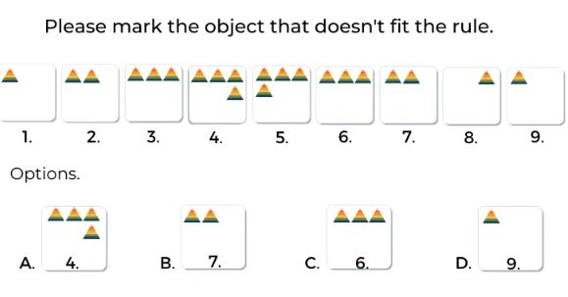
36.


Slide 46
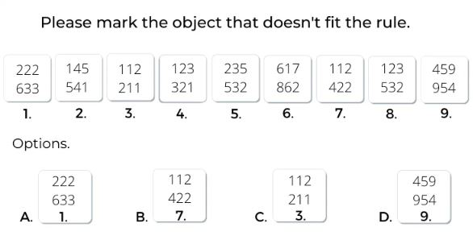
37.


Slide 47
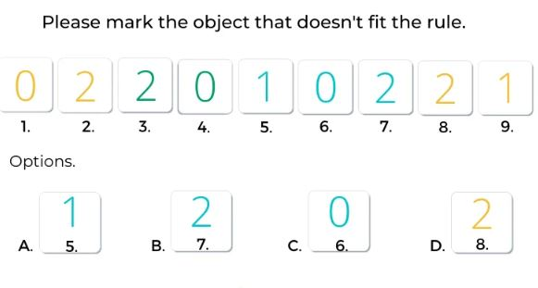

38.


Slide 48
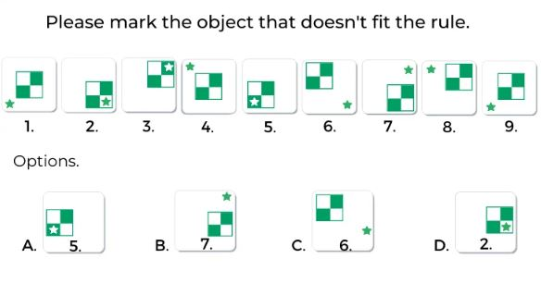
40.


Slide 49
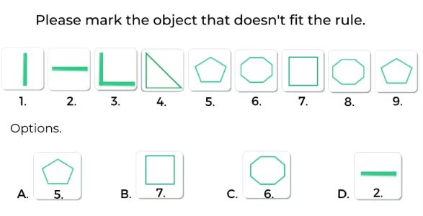
41.


Slide 50
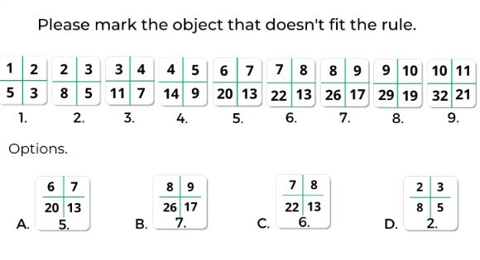
42.


Slide 51
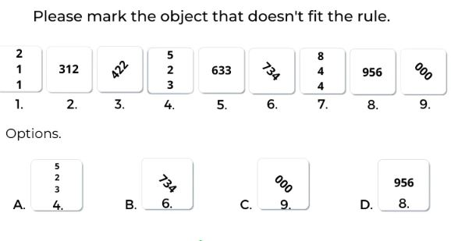
43.


Slide 52
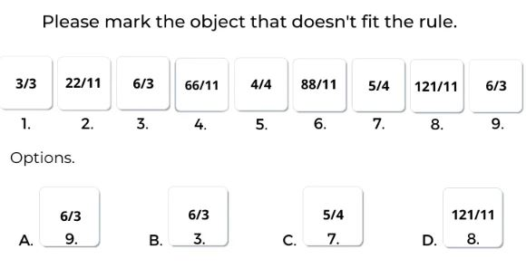
44.


Slide 53
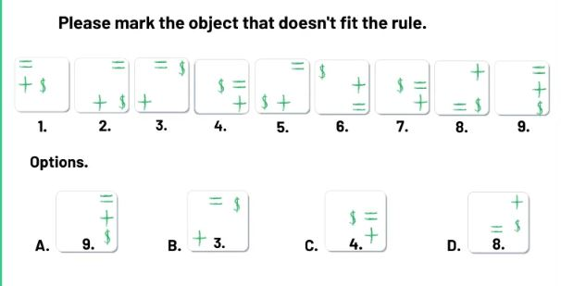
46.


Slide 54
DIGIT CHALLENGE
14 Q
A mathematical Operation needs to be solved, by using a few available digits only once.

Slide 55
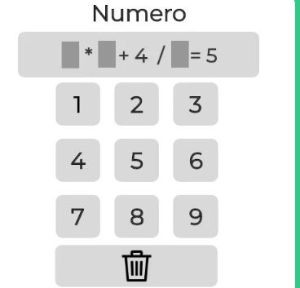
47.
a.3,1,5
b. 2,1,3
c. 3 ,1 ,2
d. 3, 2,1


Slide 56
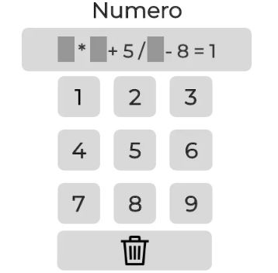
48.
A. 2, 3 , 4
B. 1, 4 ,5 C. 2 , 4 , 5 D. 2 , 3 ,5


Slide 57
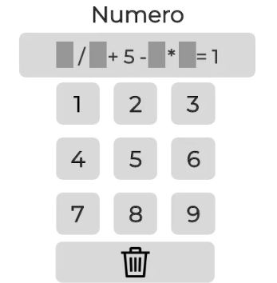
49.
A. 8 4 3 2 B. 8 4 3 1 C. 8 4 3 6
D. 12 4 3 2


Slide 58
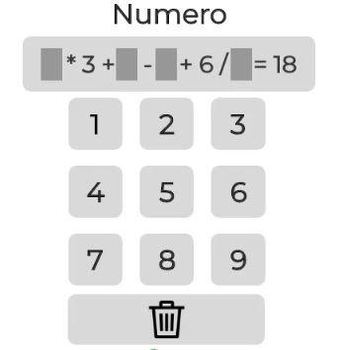
50.
A. 7 4 9 2 B. 7 5 9 3 C. 7 4 9 3 D.8 4 9 3


Slide 59
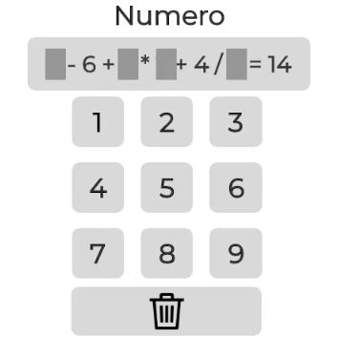
51.
A. 5 7 2 3 B. 5 7 2 4 C. 3 7 2 1 D.5 3 2 1


Slide 60
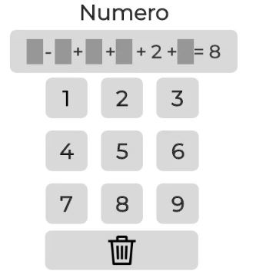
52.
A. 7 8 4 3 1 B. 5 9 4 3 1 C. 7 9 4 3 5 D.7 9 4 3 1


Slide 61
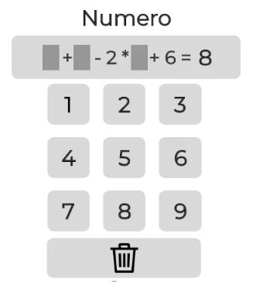
53.
A. 4 8 3
B. 3 8 5 C. 4 8 5 D. 4 3 5


Slide 62
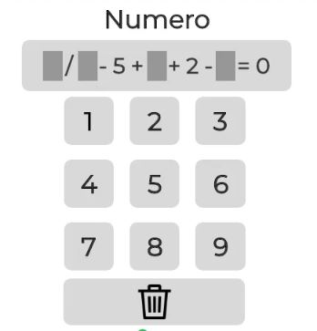
54.

A. 8 1 7 6 B. 8 3 7 6 C. 8 4 7 6 D.8 9 7 6

Slide 63
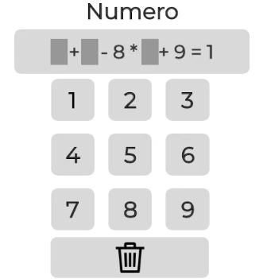
55.
A. 3 5 1 B. 3 5 2 C. 4 5 2 D.3 6 2


Slide 64
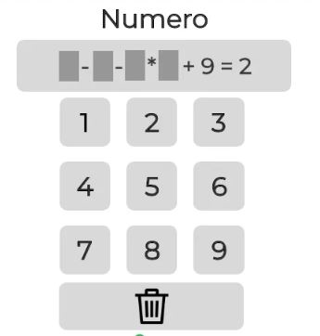
56.
A. 8 6 2 4 B. 7 6 2 5 C. 7 6 2 3 D.7 6 2 4


Slide 65
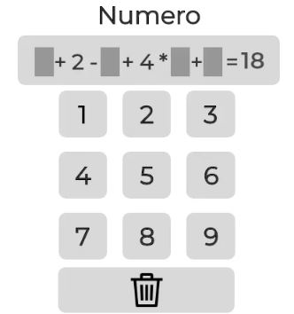
57.
A. 8 9 3 2 B. 8 9 3 5 C. 8 9 3 1 D.8 9 3 7


Slide 66
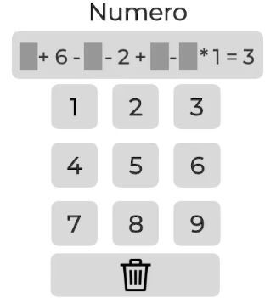
58.
A. 5 4 8 9 B. 5 3 7 9 C. 5 4 7 8 D.5 4 7 9


Slide 67
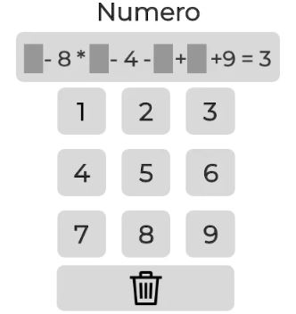
59.
A. 7 1 3 5 B. 7 1 3 2 C. 7 2 3 6 D.7 1 3 5


Slide 68
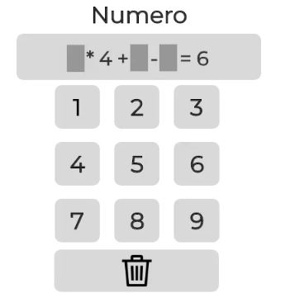
60.
A. 2 5 6 B. 2 5 7 C. 3 5 7 D.2 5 8


Slide 69
ODDO CHALLENGE
(Follow the same rule Challenge)
10 Q
You will be shown a few figures, your job is to mark other set of image/images that fit the same rules

Slide 70
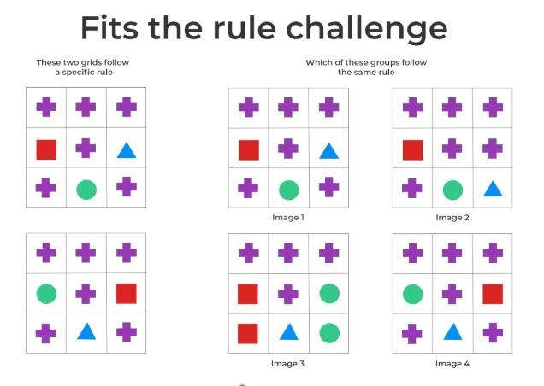
61.



Slide 71
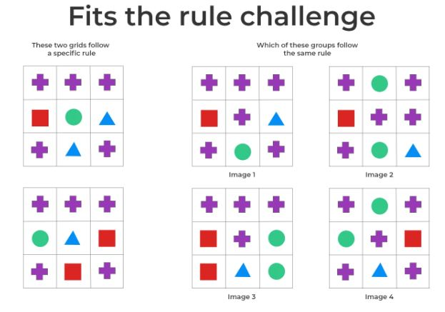
62.



Slide 72
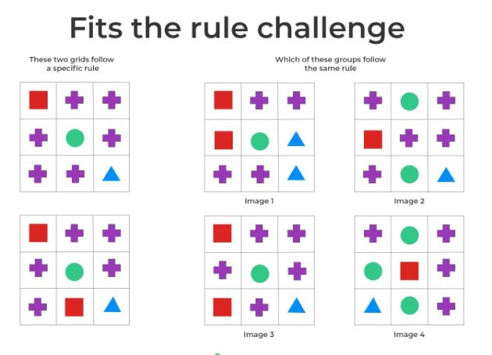
63.



Slide 73
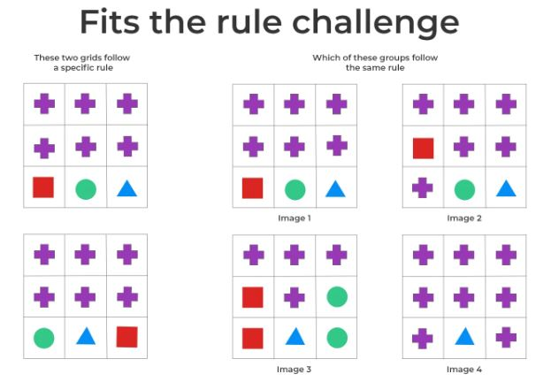
64.



Slide 74
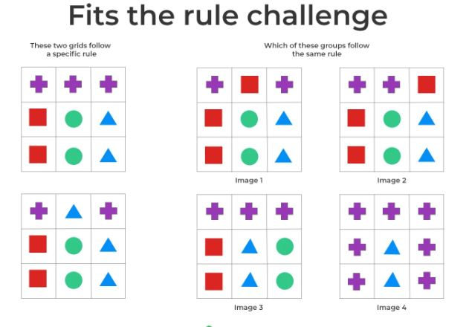
65.



Slide 75
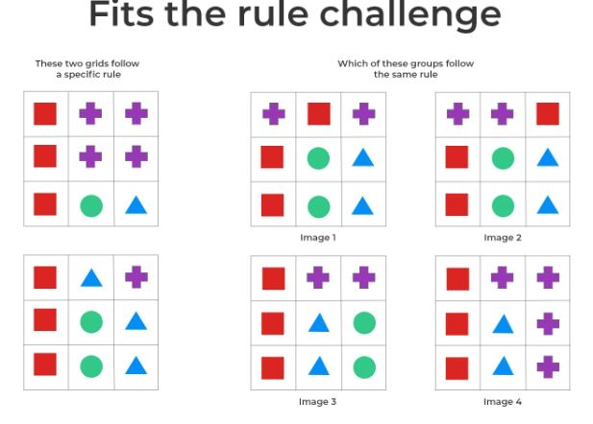
66.



Slide 76
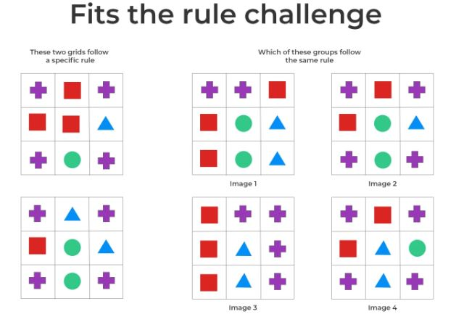
67.



Slide 77
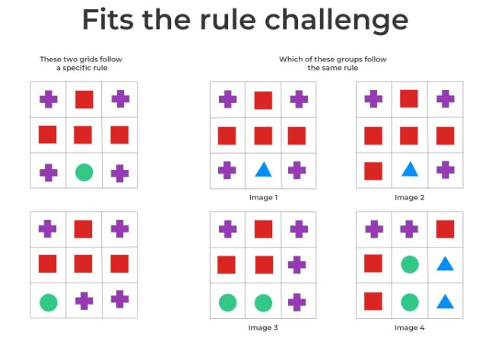
68.



Slide 78
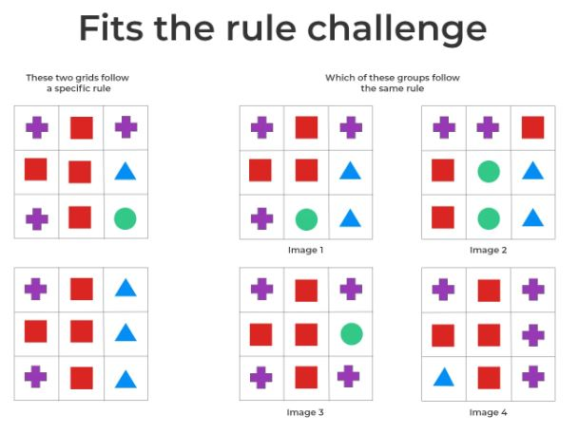
69.



Slide 79
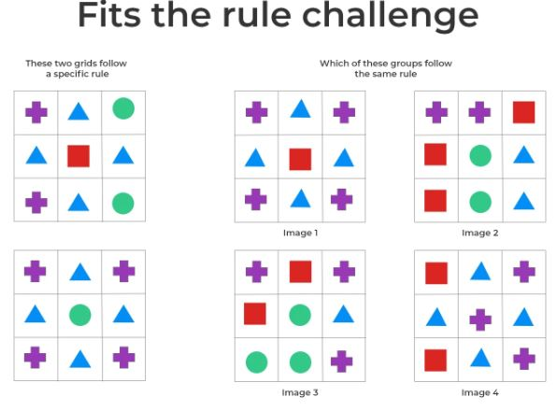
70.



Slide 80
GEO SUDOKU CHALLENGE
(Deductive logical thinking)
16 Q
Find a missing Symbol based in a 4×4 or 5×5 grid based on Geometrical Sudoku

Slide 81
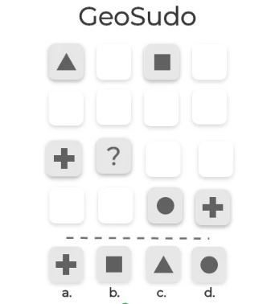
71.


Slide 82
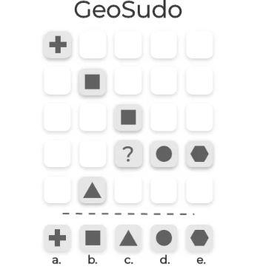
72.


Slide 83
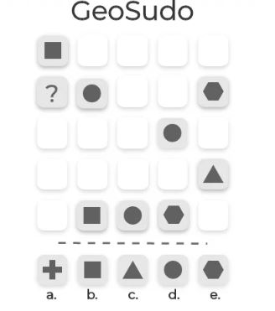
73.


Slide 84
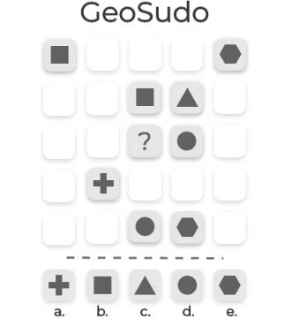
74.


Slide 85
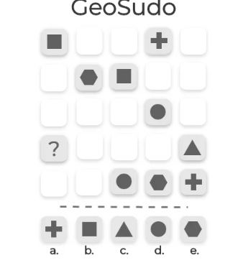
75.


Slide 86
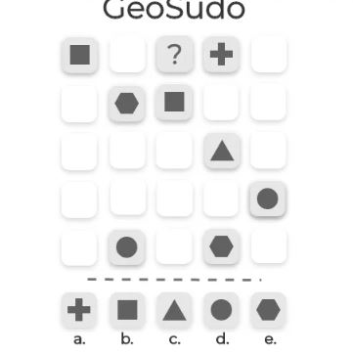
76.


Slide 87
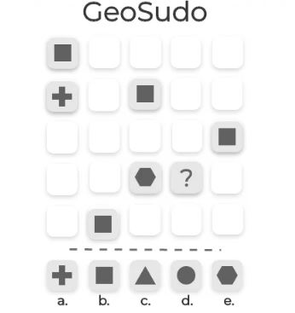
77.


Slide 88
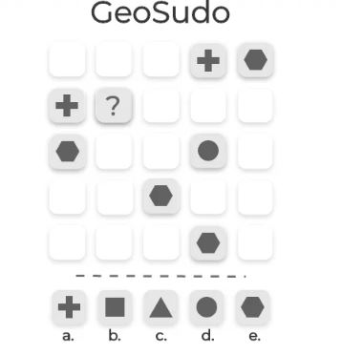
78.


Slide 89
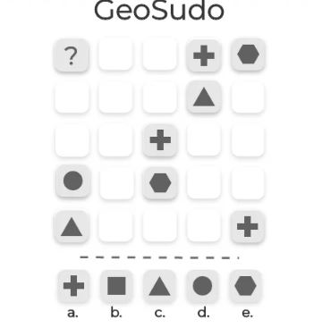
79.


Slide 90
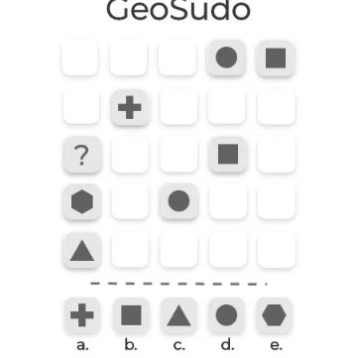
80.


Slide 91
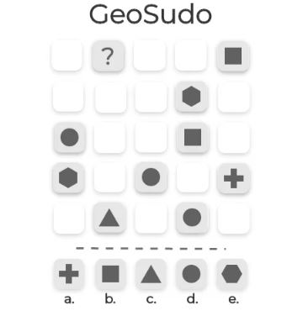
81.


Slide 92
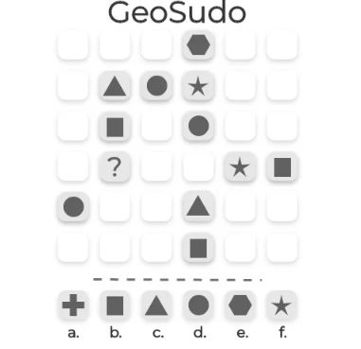
82.


Slide 93

83.


Slide 94

84.


Slide 95

85.


Slide 96

86.


Slide 97
MOTION CHALLENGE
10 Q
Your ability to plan ahead is measured.
Has puzzles, where you’ve to find path between two points in the maze, in fewer steps as possible.

Slide 98

87.
a. 4 steps
b. 5 steps
c. 6 steps
d. 7 steps


Slide 99

88.
a. 4 steps
b. 5 steps
c. 6 steps
d. 3 steps


Slide 100

89.
a. 4 steps
b. 5 steps
c. 6 steps
d. 3 steps


Slide 101

90.
a. 4 steps
b. 5 steps
c. 6 steps
d. 3 steps


Slide 102

91.
a. 4 steps
b. 5 steps
c. 6 steps
d. 7 steps


Slide 103

92.
a. 12 steps
b. 5 steps
c. 8 steps
d. 10 steps


Slide 104

93.
a. 8 steps
b. 5 steps
c. 6 steps
d. 7 steps


Slide 105

94.
a. 1 steps
b. 2 steps
c. 3 steps
d. 4 steps


Slide 106

95.
a. 6 steps
b. 8 steps
c. 10 steps
d. 12 steps


Slide 107

96.
a. 8 steps
b. 5 steps
c. 6 steps
d. 7 steps


Slide 108
GRID CHALLENGE
4 Q
Ability to focus and multi task is tested. Following needs to be done simultaneously:
1. Answering the Question asked
2. Remembering position of coordinates in a grid

Slide 109
Level - 1

Slide 110

97.

Slide 111

1.

Slide 112


Is this Mirror image?
YES
NO

Slide 113
Is this Mirror image?
NO

Slide 114
1.

Slide 115


Is this Mirror image?
YES
NO

Slide 116
Is this Mirror image?
NO

Slide 117
1.

Slide 118
Visualize correct dots in proper sequence and position (and then click)

Slide 119
1.
1

Slide 120
1.
2
1

Slide 121
Level - 2

Slide 122
98.

Slide 123
2.

Slide 124


Is this Mirror image?
YES
NO

Slide 125
Is this Mirror image?
YES

Slide 126
2.

Slide 127


Is this Mirror image?
YES
NO

Slide 128
Is this Mirror image?
YES

Slide 129
2.

Slide 130

Is this Mirror image?
YES
NO

Slide 131
Is this Mirror image?
NO

Slide 132
2.

Slide 133
Visualize correct dots in proper sequence and position (and then click)

Slide 134
2.
1

Slide 135
2.
2
1

Slide 136
2.
2
1
3

Slide 137
Level - 3

Slide 138
99.

Slide 139
3.

Slide 140


Is this Mirror image?
YES
NO

Slide 141
Is this Mirror image?
NO

Slide 142
3.

Slide 143


Is this Mirror image?
YES
NO

Slide 144
Is this Mirror image?
NO

Slide 145
3.

Slide 146


Is this Mirror image?
YES
NO

Slide 147
Is this Mirror image?
YES

Slide 148
3.

Slide 149


Is this Mirror image?
YES
NO

Slide 150
Is this Mirror image?
YES

Slide 151
3.

Slide 152
Visualize correct dots in proper sequence and position (and then click)

Slide 153
3.
1

Slide 154
3.
1
2

Slide 155
3.
1
2
3

Slide 156
3.
1
4
2
3

Slide 157
Level - 4

Slide 158
100.

Slide 159
4.

Slide 160


Is this Mirror image?
YES
NO

Slide 161
Is this Mirror image?
YES

Slide 162
4.

Slide 163


Is this Mirror image?
YES
NO

Slide 164
Is this Mirror image?
NO

Slide 165
4.

Slide 166


Is this Mirror image?
YES
NO

Slide 167
Is this Mirror image?
YES

Slide 168
4.

Slide 169


Is this Mirror image?
YES
NO

Slide 170
Is this Mirror image?
NO

Slide 171
4.

Slide 172


Is this Mirror image?
YES
NO

Slide 173
Is this Mirror image?
NO

Slide 174
4.

Slide 175
Visualize correct dots in proper sequence and position (and then click)

Slide 176
4.
1

Slide 177
4.
1
2

Slide 178
4.
1
3
2

Slide 179
4.
4
1
3
2

Slide 180
4.
4
1
3
2
5

