Slide 1


Slide 2
Game Based on Grid Challenge.

Slide 3

1.

Slide 4

1.

Slide 5


Is this Symmetrical?

Slide 6

Is this Symmetrical?

Slide 7
1.

Slide 8

Is this Symmetrical?

Slide 9

Is this Symmetrical?

Slide 10
1.

Slide 11
1.
Answer:
1
2

Slide 12
2.

Slide 13
2.

Slide 14

Is this Symmetrical?

Slide 15
Is this Symmetrical?

Slide 16
2.

Slide 17

Is this Symmetrical?

Slide 18
Is this Symmetrical?

Slide 19
2.

Slide 20
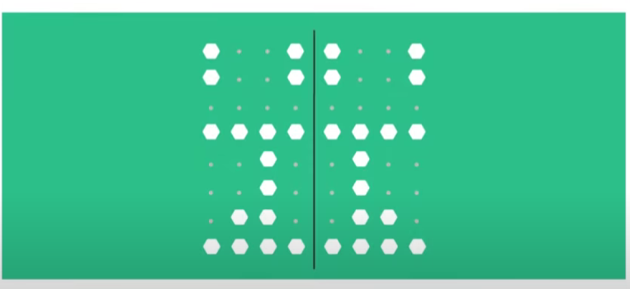
Is this Symmetrical?

Slide 21
Is this Symmetrical?

Slide 22
2.

Slide 23
2.
Answer:
2
3
1

Slide 24
3.

Slide 25
3.

Slide 26
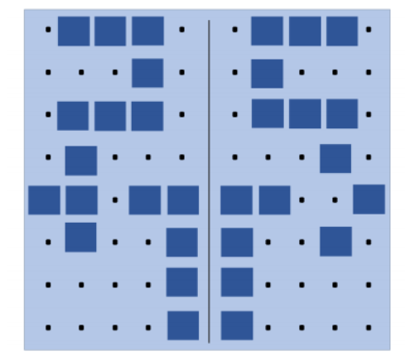
Is this Symmetrical?

Slide 27
Is this Symmetrical?

Slide 28
3.

Slide 29
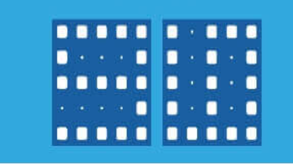
Is this Symmetrical?

Slide 30
Is this Symmetrical?

Slide 31
3.

Slide 32
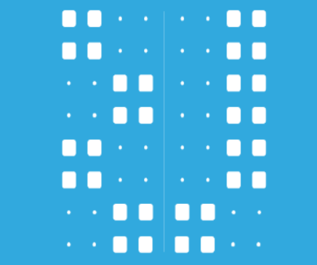
Is this Symmetrical?

Slide 33
Is this Symmetrical?

Slide 34
3.

Slide 35
3.
Answer:
2
1
3

Slide 36
4.

Slide 37
4.

Slide 38
Is this Symmetrical?

Slide 39
Is this Symmetrical?

Slide 40
4.

Slide 41
Is this Symmetrical?

Slide 42
Is this Symmetrical?

Slide 43
4.

Slide 44
4.
Answer:
2
1

Slide 45
5.

Slide 46
5.

Slide 47
Is this Symmetrical?

Slide 48
Is this Symmetrical?

Slide 49
5.

Slide 50
Is this Symmetrical?

Slide 51
Is this Symmetrical?

Slide 52
5.

Slide 53
Is this Symmetrical?

Slide 54
Is this Symmetrical?

Slide 55
5.

Slide 56
Is this Symmetrical?

Slide 57
Is this Symmetrical?

Slide 58
5.

Slide 59
5.
Answer:
24
3
4
14

Slide 60

?
?
?
…….

