Slide 1


Slide 2
Game Based on Grid Challenge.

Slide 3

1.
Remember the position of dot

Slide 4

1.

Slide 5


Is this Symmetrical?

Slide 6

Is this Symmetrical?

Slide 7
1.
Remember the position of dot

Slide 8

Is this Symmetrical?

Slide 9

Is this Symmetrical?

Slide 10
1.
Mark the positions of dots with proper sequence (imp)

Slide 11
1.
Answer:
1
2

Slide 12
2.
Remember the position of dot

Slide 13
2.
Remember the position of dot

Slide 14

Is this Symmetrical?

Slide 15
Is this Symmetrical?

Slide 16
2.
Remember the position of dot

Slide 17

Is this Symmetrical?

Slide 18
Is this Symmetrical?

Slide 19
2.
Remember the position of dot

Slide 20

Is this Symmetrical?

Slide 21
Is this Symmetrical?

Slide 22
2.
Mark the positions of dots with proper sequence (imp)

Slide 23
2.
Answer:
2
3
1

Slide 24
3.
Remember the position of dot

Slide 25
3.

Slide 26
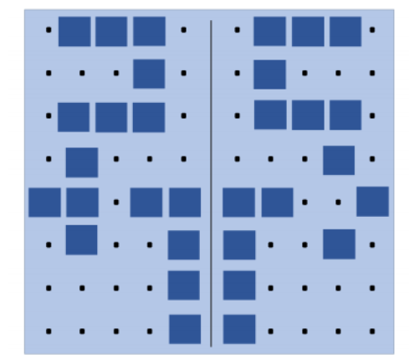
Is this Symmetrical?

Slide 27
Is this Symmetrical?

Slide 28
3.
Remember the position of dots

Slide 29

Is this Symmetrical?

Slide 30
Is this Symmetrical?

Slide 31
3.
Remember the position of dot

Slide 32

Is this Symmetrical?

Slide 33
Is this Symmetrical?

Slide 34
3.
Mark the positions of dots with proper sequence (imp)

Slide 35
3.
Answer:
2
1
3

Slide 36
4.
Remember the position of dot

Slide 37
4.
Remember the position of dot

Slide 38
Is this Symmetrical?

Slide 39
Is this Symmetrical?

Slide 40
4.
Remember the position of dot

Slide 41
Is this Symmetrical?

Slide 42
Is this Symmetrical?

Slide 43
4.
Mark the positions of dots with proper sequence (imp)

Slide 44
4.
Answer:
2
1

Slide 45
5.
Remember the position of dot

Slide 46
5.
Remember the position of dot

Slide 47
Is this Symmetrical?

Slide 48
Is this Symmetrical?

Slide 49
5.
Remember the position of dot

Slide 50
Is this Symmetrical?

Slide 51
Is this Symmetrical?

Slide 52
5.
Remember the position of dot

Slide 53
Is this Symmetrical?

Slide 54
Is this Symmetrical?

Slide 55
5.
Remember the position of dot

Slide 56
Is this Symmetrical?

Slide 57
Is this Symmetrical?

Slide 58
5.
Mark the positions of dots with proper sequence (imp)

Slide 59
5.
Answer:
24
3
4
14

Slide 60

?
?
?
…….

